Slide 1


Strategic use of
Generative AI
4Research
Alexander Botzki and Bruna Piereck
https://shorturl.at/3vLsH
_______C C B Y 4.0_______
Notes:
https://broneager.com/wp-content/uploads/2024/06/AI-for-Research-Workbook-Bron-Eager-V20240603.pdf
https://scite.ai/
Cape town: https://docs.google.com/document/d/14XaTVheTtr7XpDWX33OthT4piMHnYUfl/edit

Slide 2
Primary considerations

Slide 3
VIB Policy

Slide 4
VIB wants:
1. To stimulate the responsible use of genAI
2. You to be fully aware of the strengths but also the limitations of genAI
3. You to perform the necessary verification and quality control
4. You to refrain from the use of genAI in a way that may lead to the disclosure of confidential or personal information
See practical guideline on the responsible use of genAI tools

Slide 5
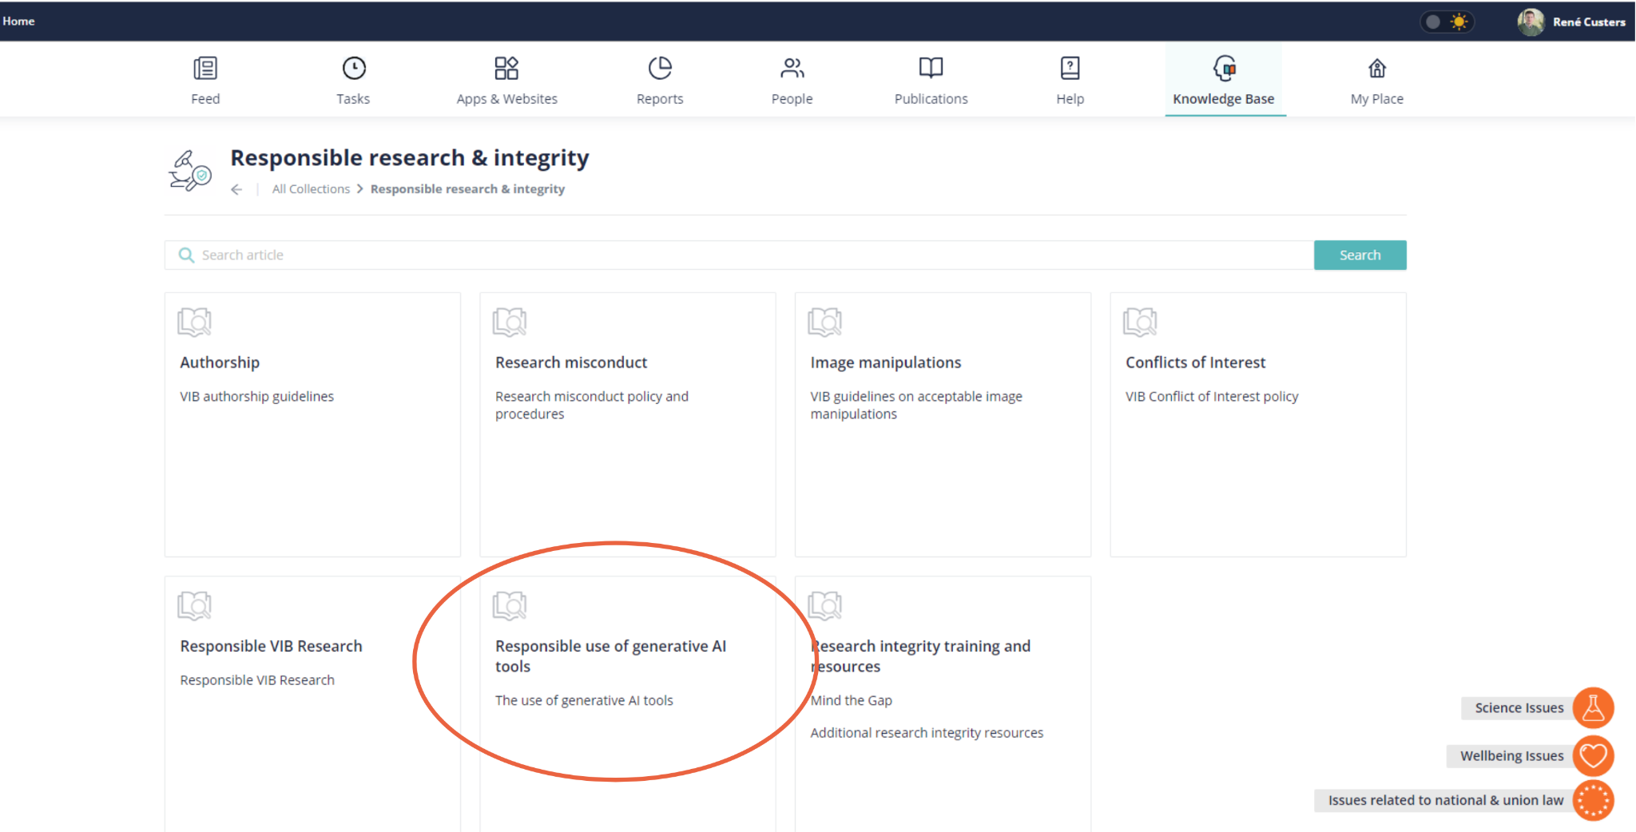
Discover the whole document on kb.vib.be

Slide 6
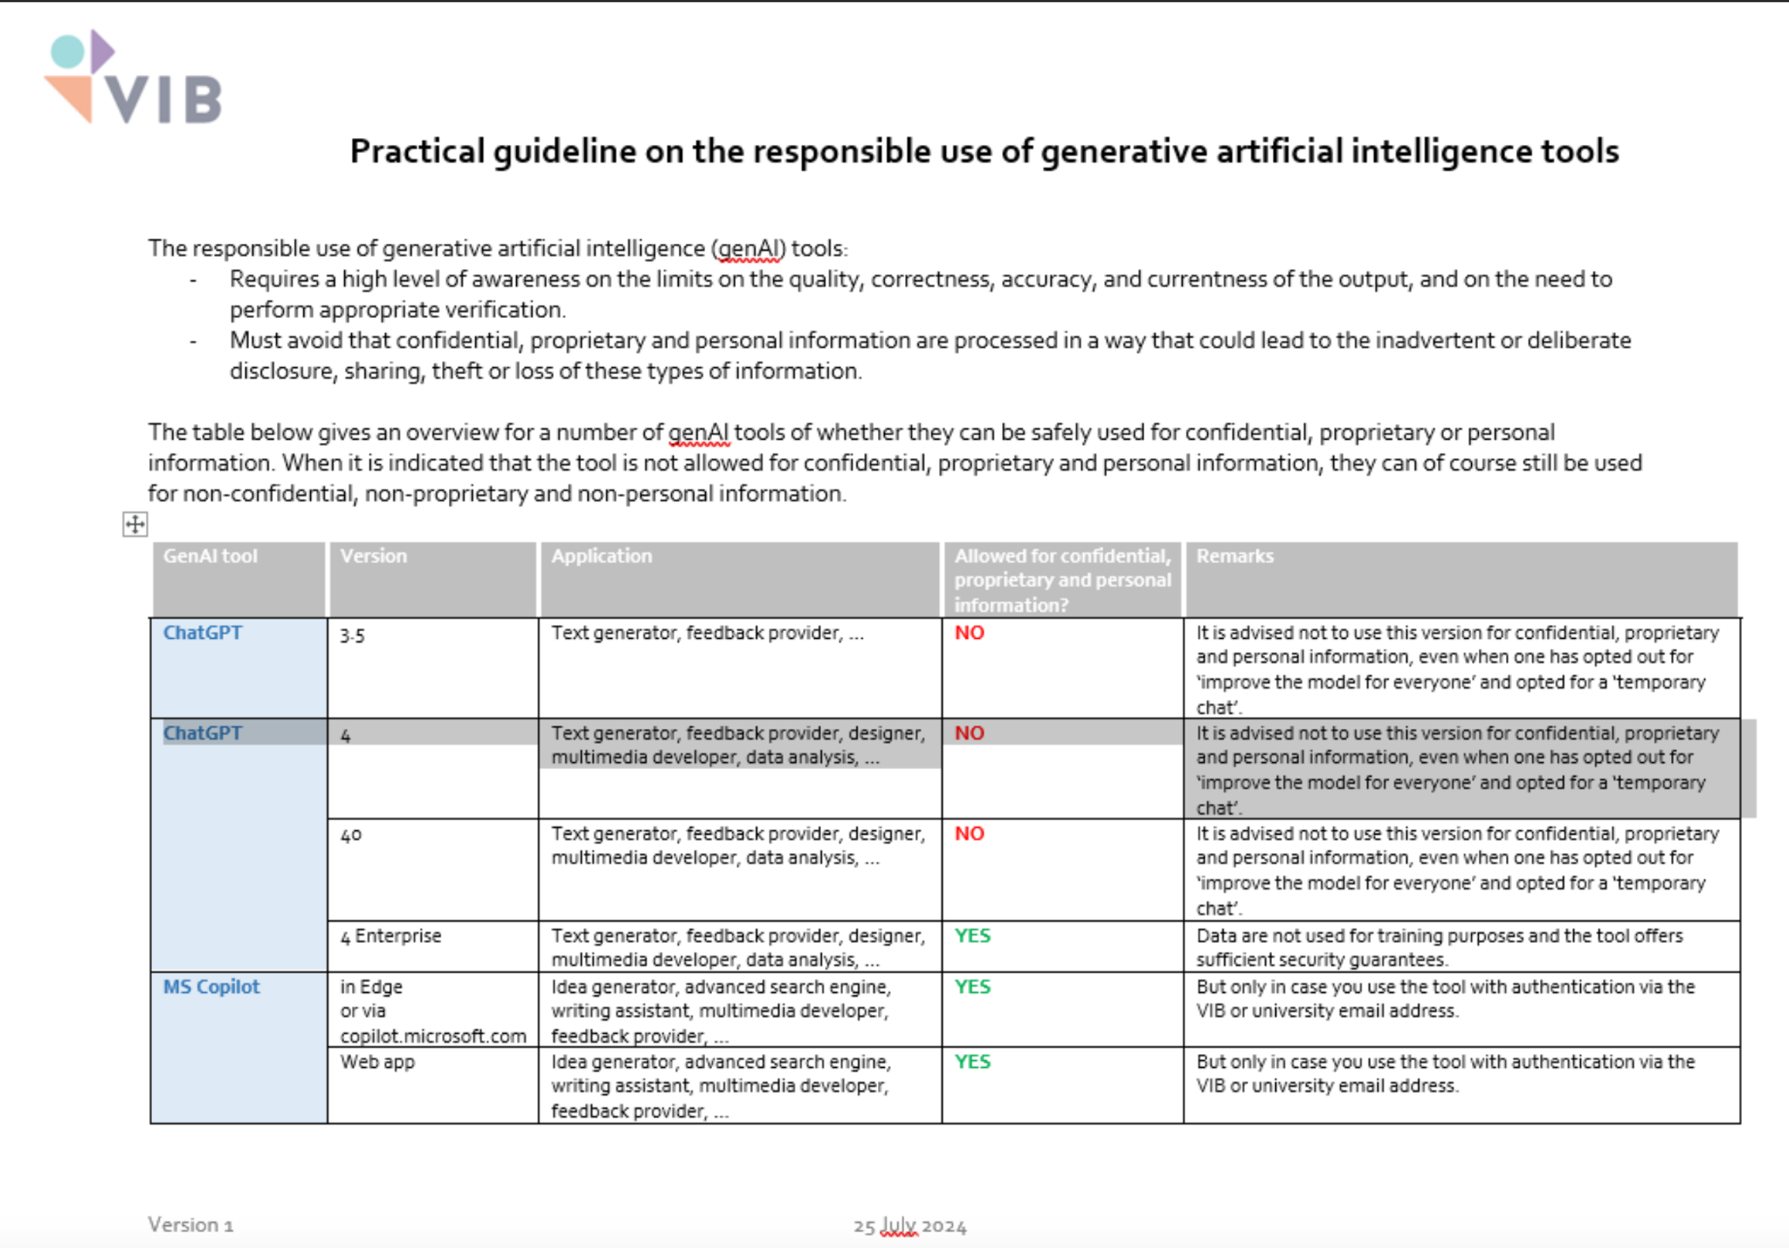
Some practical guidelines

Slide 7


Considerations
before we start
Input
Be careful
Output
Notes:
https://www.freepik.com/icon/upload_15423209#fromView=search&page=1&position=0&uuid=6337ce6c-9400-4e68-a14d-ae390dc4c0bc
https://www.freepik.com/icon/download_8163379#fromView=resource_detail&position=10

Slide 8
Considerations
before we start
Input
Upload files like PDFs
Copy & paste information
Enter something new into the LLM interface
Be careful
Output
Notes:
https://www.freepik.com/icon/upload_15423209#fromView=search&page=1&position=0&uuid=6337ce6c-9400-4e68-a14d-ae390dc4c0bc
https://www.freepik.com/icon/download_8163379#fromView=resource_detail&position=10

Slide 9
Considerations
before we start
Input
Upload files like PDFs
Copy & paste information
Enter something new into the LLM interface
Be careful
Reading content created by AI
Using content created by AI in own works
Adapt content created by AI
Output
Notes:
https://www.freepik.com/icon/upload_15844566#fromView=resource_detail&position=8
https://www.freepik.com/icon/cloud_15844574#fromView=resource_detail&position=6

Slide 10
Considerations
About input
Non-Open Access Content
Many publishers have policies that restrict the uploading of their content, even if some might argue it falls under “Fair Use.”
Confidential Information
Information that is subject to a non-disclosure agreement or classified.
Input
Unpublished material
A peer reviewer using e.g. Copilot to summarize or better understand the material they are reviewing.
Notes:
https://www.freepik.com/icon/upload_15844566#fromView=resource_detail&position=8
https://www.freepik.com/icon/cloud_15844574#fromView=resource_detail&position=6
Let’s get into some specifics. Here are some examples of things you COULD upload but may want to pause before doing so:
As VIB students, faculty, and staff, you have access to lots of scholarly literature. At the moment, simply uploading, for example, a Nature paper that isn’t open access may or may not be considered “fair use” from a copyright perspective, and also my guess is we will see MUCH more about this question from the legal arena in the coming months and possibly years.
However, some publishers - who hold the copyright on content - are starting to say “do not upload our content to AI tools” as part of their terms of service.
Here’s a specific example: ASTM Compass is a database that contains engineering standards among some other types of resources. Engineering librarians use this fairly frequently. They have a specific AI Policy that states:
“ASTM International prohibits the entry of ASTM standards and related ASTM intellectual property (“ASTM IP”) into any form of Artificial Intelligence (AI) tools, such as ChatGPT. … In the case of such use, ASTM will suspend a licensee’s access to ASTM IP, and further legal action will be considered.”
What they are saying pretty clearly is: do not upload their standards to chatGPT. If they realize you have done this, they can revoke U-M’s access to this database (and I’ll note that our electronic resources from this site have a digital watermark so if it ever did get back to the publisher, they’d be able to tell where the PDFs came from)!
Many many publishers are developing policies and terms of service around this - and we’ll circle back on this topic in Tyler’s section - but for now, just know that uploading content could violate these kinds of policies and terms and there’s some level of risk involved with that.
Maybe you are working on a project with materials subject to a non-disclosure agreement or maybe you are working with classified documents.
Again, it’s probably not great to upload this kind of content to these AI companies via their platforms because doing so would probably violate the terms of the agreement (though, read the fine print I guess?).
Let’s say you have access to something unpublished:
Maybe a post-doc in your research group wrote a paper and asked you to give comments on it
While there may not be a copyright-related reason why you shouldn’t upload this work to something like ChatGPT, there may be ethical and community norms around that kind of practice.
The models can use this text in their answers to others which can possibly jeopardize the original authors’ publication process!
However, we just saw a post in the Nature Careers Community from a researcher talking about how he specifically DOES use ChatGPT to help him craft his peer review responses - so the ethical and community norms have yet to be settled here.
Maybe you are thinking “oh but I would never ever do any of these things!”
Wonderful! Great news. HOWEVER someone in your research group might - so again, we point back to our recommendation that you should have a conversation with your collaborators and stakeholders because these are real issues with real consequences and the norms and rules are evolving.

Slide 11
Considerations
About output
Content may
be incomplete
contain errors
be misleading or inaccurate
exhibit biases
have intellectual property concerns
Output
Notes:
https://www.freepik.com/icon/upload_15844566#fromView=resource_detail&position=8
https://www.freepik.com/icon/cloud_15844574#fromView=resource_detail&position=6 Now, many tools generate content - or, create an output - whether that’s text, audio, visual, etc.
Imagine Copilot or alike - the text that’s generated from a prompt:
Can absolutely be incomplete, have errors, or be hallucinations
It can have major biases
It can infringe on some person or some publisher’s intellectual property rights (because the models are trained using materials covered by IP rights)
Again, if you ask AI to generate content (like a summary of an article) it is possible that content could be VERY similar to existing copyrighted material, which means you might be plagiarising something without even realizing it. This can happen for images and audio too, not just for text.
And depending on what you are doing, even generating certain types of content can also violate terms of service! Remember the ASTM standards policy that prohibits you from uploading their content to chatgpt? They ALSO say: “Additionally, creating derivatives of ASTM IP using AI is also prohibited without express written permission from ASTM’s President.” Which is kind of wild!
Still: we recognize there is SO much interest in these tools from all corners of our community, so, play around with these tools but please pause and assess what you are giving these tools and what these tools share with you.

Slide 12
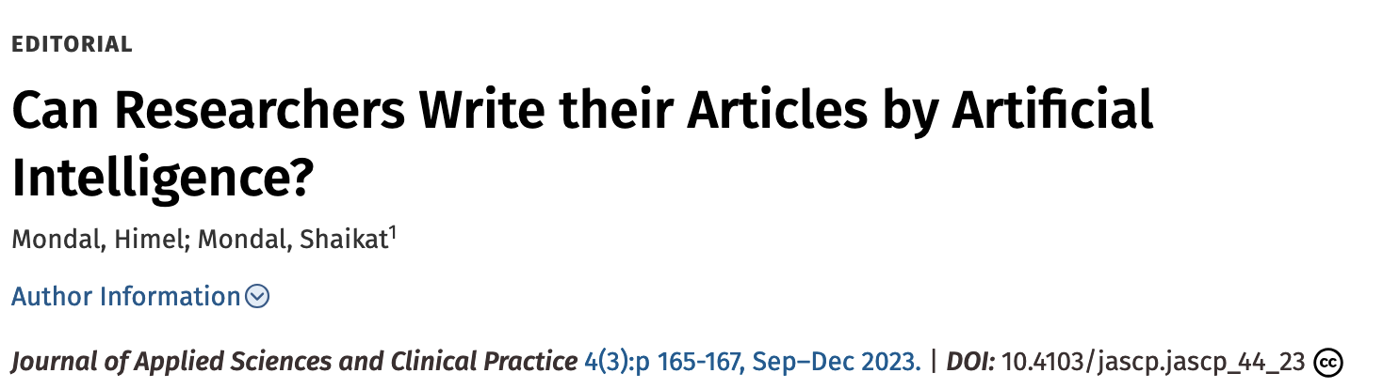
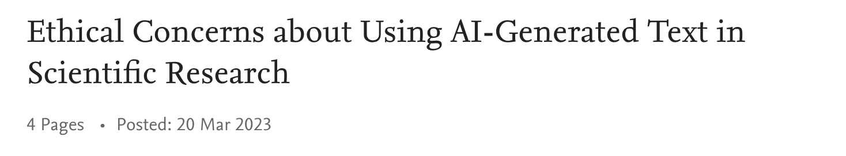
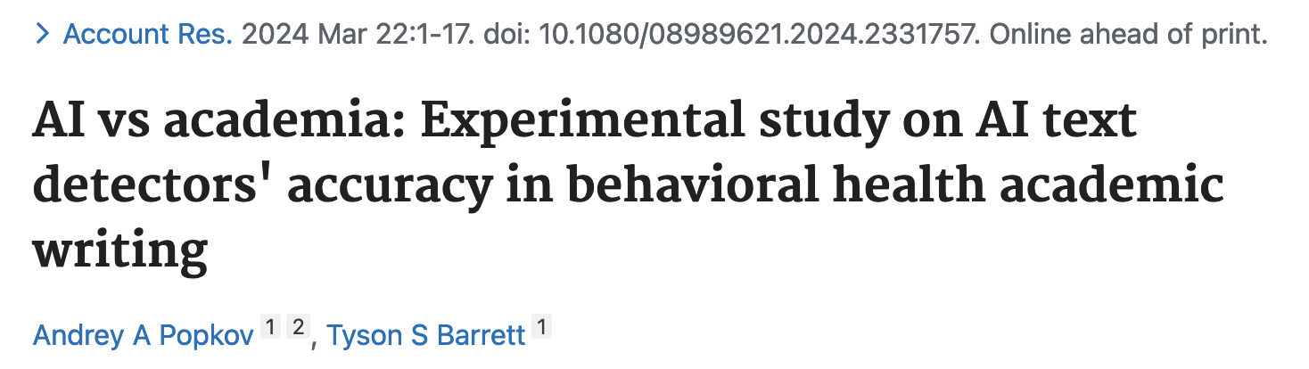
Recent headlines
before we start
Notes:
https://www.freepik.com/icon/upload_15423209#fromView=search&page=1&position=0&uuid=6337ce6c-9400-4e68-a14d-ae390dc4c0bc
https://www.freepik.com/icon/download_8163379#fromView=resource_detail&position=10

Slide 13
Dimensions of the writing process
Depth
Ideas, sources, analysis, variety and range of language
Flow
Smooth expression, clear connection, fluency
Accuracy
Precise spelling, grammar, punctuation,
citations formatting
Notes:
https://www.freepik.com/icon/upload_15423209#fromView=search&page=1&position=0&uuid=6337ce6c-9400-4e68-a14d-ae390dc4c0bc
https://www.freepik.com/icon/download_8163379#fromView=resource_detail&position=10 Writing a research paper involves several critical dimensions that contribute to its overall quality and effectiveness. Depth is essential, as it encompasses the thorough exploration of ideas, the integration of diverse sources, and detailed analysis. A variety and range of language are crucial to articulate complex concepts and present a well-rounded argument. Flow is another key dimension, ensuring that the paper exhibits smooth expression, clear connections between ideas, and overall fluency. This helps maintain the reader’s engagement and ensures that the argument progresses logically. Accuracy is equally important, as it involves precise spelling, grammar, punctuation, and proper citation formatting. Attention to these details not only enhances the professionalism of the paper but also upholds academic integrity by giving due credit to original sources. Together, these dimensions create a comprehensive and compelling research paper.

Slide 14
AI use in the writing process
Increasing AI
Human writing
Human-in-the-Loop Writing
Machine-in-the-loop Writing
Synthetic Writing
Individual perspective pieces
Cultural analysis
Subject-specific evaluation
Philosophical discussion
Essay feedback
Creation of educational material
Tools language acquisition
Guidance on thesis work
Low-stake assignment feedback
Early drafts
Enhanced peer review
Prompts for discussions
Analysis reports
Formatting citations
Articles summaries
Adapted from: Knowles, A. M. (2024). Machine-in-the-loop writing: Optimizing the rhetorical load.Computers and Composition, 71, 102826. https://doi.org/10.1016/j.compcom.2024.102826 https://moxielearn.ai/blog/how-to-use-ai-for-academic-writing-a-step-by-step-guide;
Notes:
https://www.freepik.com/icon/upload_15423209#fromView=search&page=1&position=0&uuid=6337ce6c-9400-4e68-a14d-ae390dc4c0bc
https://www.freepik.com/icon/download_8163379#fromView=resource_detail&position=10 The dimensions of AI in the writing process encompass various roles and contributions, each enhancing the writing experience in unique ways. Human writing remains at the core where you might focus on individual perspective pieces, cultural analysis, subject-specific evaluation, and philosophical discussion. These elements highlight the irreplaceable human touch in crafting nuanced and deeply personal content.
In Human-in-the-Loop Writing, AI assists by providing essay feedback, aiding in the creation of educational materials, offering tools for language acquisition, and guiding thesis work. This collaborative approach leverages AI to enhance human creativity and precision, ensuring that writers receive valuable support while maintaining control over their work.
Machine-in-the-Loop Writing involves AI taking on more autonomous roles, such as giving feedback on low-stakes assignments, generating early drafts, enhancing peer reviews, and providing prompts for discussions. This dimension allows for efficient handling of repetitive tasks, freeing up human writers to focus on more complex aspects of their work.
Finally, Synthetic Writing showcases AI’s capabilities in generating analysis reports, formatting citations, and summarizing articles. These tasks, often time-consuming for humans, are efficiently managed by AI, ensuring accuracy and consistency while allowing writers to concentrate on content creation and critical thinking. Together, these dimensions illustrate the multifaceted role of AI in the writing process, enhancing productivity and creativity across various stages of writing.

Slide 15
AI-assisted literature discovery and analysis
Develop a search strategy
Flavors of literature search tools
Screen and triangulate your results
Organize selected literature into a matrix
Analyse to identify patterns & gaps
Synthesise and write
Revise
Notes:
Now, let’s dive in where AI tools can help us in the whole writing process. AI-assisted literature discovery and analysis involves a structured approach to efficiently navigate and synthesize vast amounts of information. The first step is to develop a search strategy, which involves defining the scope and keywords for your research. This ensures that your search is focused and relevant. Next, explore the various flavors of literature search tools available, each offering unique features to help you screen and triangulate your results. This step is crucial for filtering out irrelevant information and honing in on the most pertinent studies.
Once you have a curated list of literature, organize the selected works into a matrix. This helps in systematically analyzing the content to identify patterns and gaps in the existing research. By visualizing the data in this way, you can more easily spot trends and areas that require further investigation.
The final steps involve synthesizing and writing your findings, followed by a thorough revision. Synthesis involves integrating the insights from your analysis into a coherent narrative, while revision ensures that your work is polished and free of errors. This comprehensive approach leverages AI to streamline the literature review process, making it more efficient and effective.

Slide 16
Easy start:
AI excels for search strategies

Slide 17
LLMs excel at certain questions
Unfamiliar concepts
What are the key trends in the development of sustainable flow cytometry devices?
As someone new to Digital Education, I believe these tools and methods could be beneficial. Could you provide an overview?
Which stakeholders should be engaged in establishing an eco-team at a research-performing organisation?
Notes:
Still, it’s not all doom and gloom! Let me suggest a more successful way to think about using Copilot:
Start with questions at the beginning of your research journey like:
What are the key trends in the development of sustainable flow cytometry devices?
Note: asking these tools for the absolute latest trends doesn’t work well because their content has a time lag (they don’t have the latest content from the internet)
As someone new to Digital Education, I believe these tools and methods could be beneficial. Could you provide an overview?
Which stakeholders should be engaged in establishing an eco-team at a research-performing organisation?
With this approach, you can get some information and ideas on topics you aren’t yet very familiar with. After getting some initial responses from the tools, THEN you can head over to other platforms that are reliable and relevant (tried and true) for your next steps: platforms like the library catalog, library databases, even google scholar. When approached in this way, these tools can be helpful when you are doing interdisciplinary research or are new to a sub-field.

Slide 18
LLMs excel at certain questions
GENERATE KEYWORDS | SEARCH STRING SUGGESTIONS | TOPIC SCOPING
Possible prompt
As a sociologist researching collaboration among scientists in biology labs, provide me with 10 keywords for an academic literature search.
Follow-up prompts
What search string could I use in PubMed or a library database to find relevant literature? Give an example for each of the options.
Identify 5 specific topics in this area for further exploration. Create an additional search string for PubMed.
Notes:
Let me suggest a more successful way to think about using Copilot:
Zoom in to a specific question and focus on generating keywords, search strings, with subsequent topic scoping:
As a sociologist researching collaboration among scientists in biology labs, provide me with 10 keywords for an academic literature search.
Note: asking these tools for the absolute latest trends doesn’t work well because their content has a time lag (they don’t have the latest content from the internet)
What search string could I use in PubMed or a library database to find relevant literature? Give an example for each of the options.
Identify 5 specific topics in this area for further exploration. Create an additional search string for PubMed.
Let’s go an activity.

Slide 19
Activity
GENERATE KEYWORDS | SEARCH STRING SUGGESTIONS | USE TOOL | TOPIC SCOPING
https://copilot.cloud.microsoft.com
Possible prompt
As a sociologist researching collaboration among scientists in biology labs, provide me with 10 keywords for an academic literature search.
Follow-up prompts
What search string could I use in Google Scholar to find relevant literature?
Use the suggested search string in Google scholar and evaluate the results.
Identify 5 specific topics in this area for further exploration.
Notes:
Open your browser and surf to https://copilot.microsoft.com
“use for proprietary, confidential, and personal information allowed”
Zoom in to a specific question and focus on generating keywords, search strings, with subsequent topic scoping:
As a sociologist researching collaboration among scientists in biology labs, provide me with 10 keywords for an academic literature search.
What search string could I use in Google Scholar to find relevant literature?
Answer: ("scientific collaboration" OR "interdisciplinary research" OR "team science" OR "coauthorship" OR "research networks" OR "lab dynamics" OR "collaborative innovation" OR "knowledge sharing" OR "academic partnerships" OR "collaborative research practices") AND "biology labs"
Use the suggested search string in Google scholar and evaluate the results.
Identify 5 specific topics in this area for further exploration. Answer: Here are five specific topics related to collaboration among scientists in biology labs that you might find interesting for further exploration:
Impact of Interdisciplinary Collaboration on Scientific Innovation: Investigate how collaboration across different scientific disciplines within biology labs influences innovation and the development of new research methodologies.
Role of Technology in Facilitating Collaboration: Explore how digital tools and platforms are used to enhance communication, data sharing, and collaborative efforts among scientists in biology labs.
Challenges and Solutions in International Research Collaborations: Examine the specific challenges faced by international research teams, such as cultural differences, language barriers, and time zone issues, and how they overcome these obstacles.
Gender Dynamics in Scientific Collaboration: Analyze how gender influences collaboration patterns, leadership roles, and the distribution of credit in collaborative research projects within biology labs.
Effects of Institutional Policies on Collaborative Research: Study how different institutional policies and funding mechanisms impact the nature and success of collaborative research efforts in biology labs.
Create an additional search string for PubMed.

Slide 20
AI-assisted literature review
Develop a search strategy
Flavors of literature search tools
Screen and triangulate your results
Organize selected literature into a matrix
Analyse to identify patterns & gaps
Synthesise and write
Revise
Notes:
After this exercise, we dive into the next step.

Slide 21
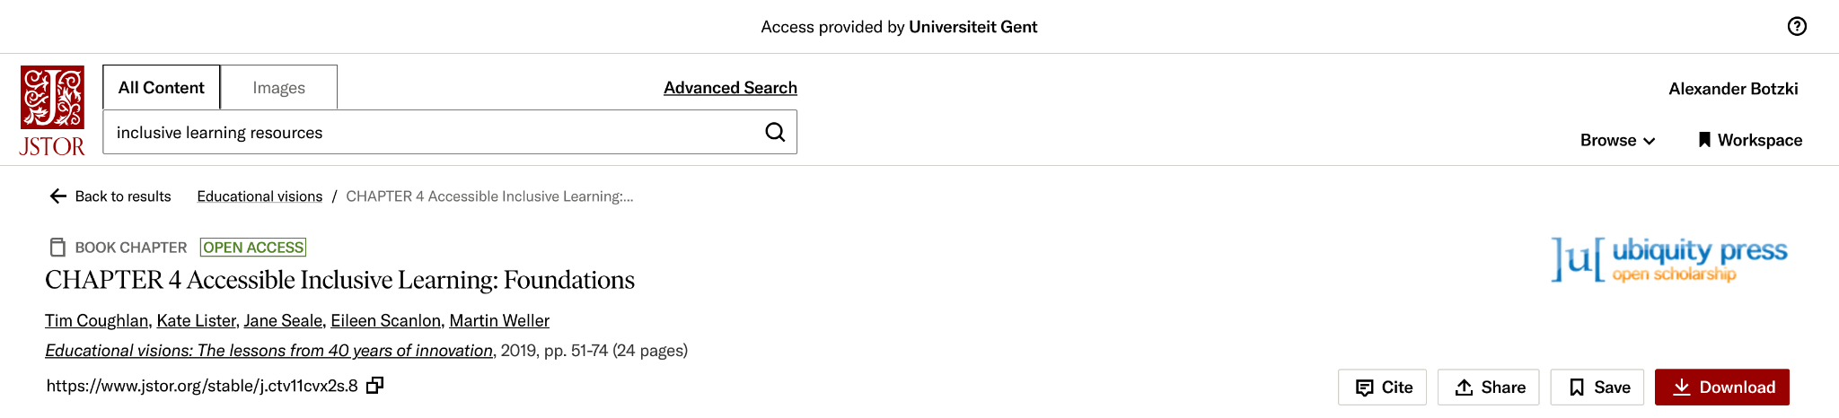
AI Assistance in Library tools
https://www.jstor.org
Notes:
AI assistance in library tools is revolutionizing the way researchers access and analyze information, with the JSTOR AI extension currently in beta testing serving as a prime example. This innovative tool integrates generative AI to enhance the research experience, allowing users to delve deeper into JSTOR’s extensive corpus. By employing natural language processing, the extension enables more intuitive searches, providing relevant results that go beyond traditional keyword matching
Once a search is conducted, the AI tool assists in evaluating and exploring content by highlighting key points and arguments, making it easier to assess the relevance of the material. This feature is particularly useful for skimming through large volumes of text to find pertinent information quickly¹. Additionally, the tool supports users in discovering related topics and enriching their research with similar content from JSTOR’s vast database².
The interactive nature of the JSTOR AI extension also allows for a conversational approach to research. Users can ask questions in natural language and receive quick, accurate answers, facilitating a more dynamic and engaging research process². This beta tool exemplifies how AI can streamline literature discovery and analysis, making academic research more efficient and effective.

Slide 22

Semantic Scholar: a corpus for AI models in academia
Notes:
Now that we’ve talked about models and corpora - we wanted to shine a spotlight on Semantic Scholar, a corpus that underpins many AI tools designed for and marketed to academics - so it’s useful to know a bit about this entity:
Semantic Scholar was established in 2015 and it is run by the nonprofit Allen Institute for AI based in Seattle.
According to them, “Semantic Scholar provides free, AI-driven search and discovery tools, and open resources for the global research community.”
They index over 200 million academic papers sourced from publisher partnerships, data providers, and web crawls.
When thinking about the bias AI tools may introduce into your research endeavors, because many AI tools designed for and marketed towards an academic audience use the semantic scholar corpus as their data, consider that they focus on:
academic journal articles and preprints not books, datasets, patents, etc.
Their corpus is primarily in English, though they would like to support other languages in the future
And finally they are very clear in their FAQs that they started with a focus on all fields of science so science materials are heavily represented, and social sciences and humanities are comparatively underrepresented.

Slide 23


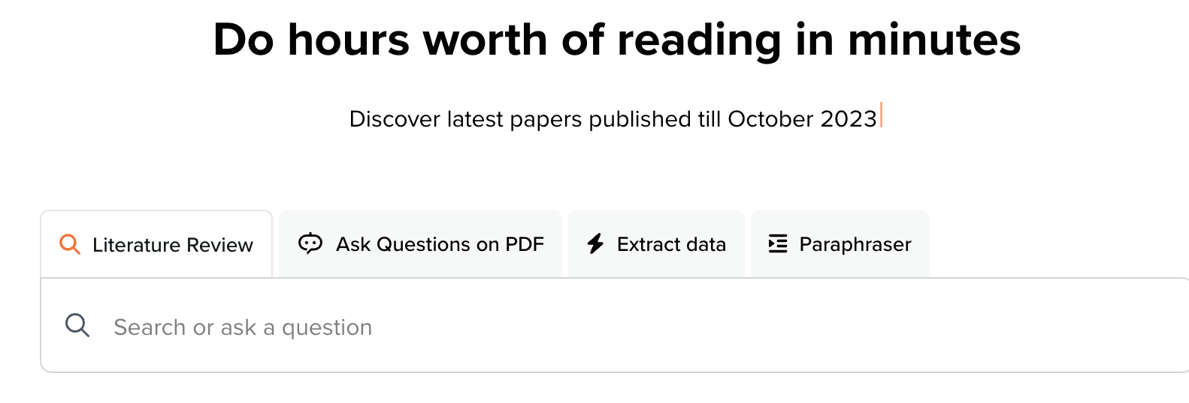
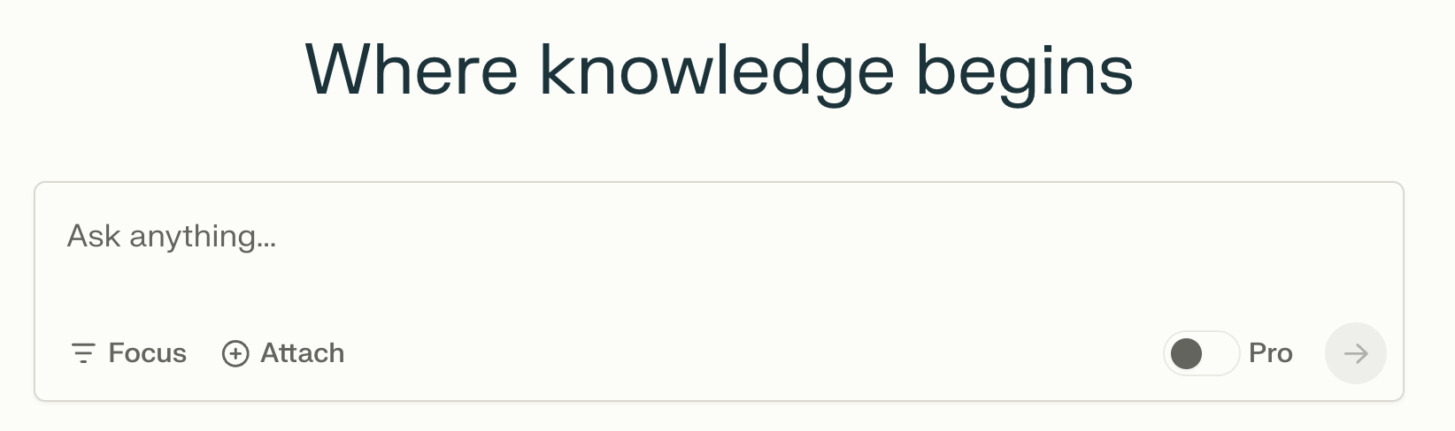


Chatbots for Literature Discovery

Slide 24
Activity
- Open your browser and surf to https://perplexity.ai
- Open another tab and surf to https://scholar.google.com
Question to address:
How to make training events and material more findable, accessible, interoperable and re-usable?
List practical recipes to make training events and material more findable, accessible, interoperable and re-usable.
How do you need to change the question to get more concrete answers?
Try to come up with concrete practical recipes which would help you how to do it.
Document your process and evaluate what are useful approaches for both tools.

Slide 25

Interrogate new tools that have a chatbot
Ask the tool or Perplexity about the new tool
What can you do for free and what can you do with paid accounts?
What are the data sources the tools are using?
What models is the tool relying on?
What other things will this tool do? Summarise
Alerts
Citation connected to Zotero
etc.
Notes:
So when you encounter a new AI tool for literature discovery that has chatbot functionality, interrogate it! Ask:
What can you do for free and what can you do with paid accounts?
What are the data sources the tools are using?
Many of these tools use the semantic scholar corpus, but others may use this and other data sources (scholarly and non); usually it’s not very clear what the corpus is
Some of you might be interested in specifically what models are they relying on
And also what other things will this tool do?
Summarize research?
Set up alerts?
Add collaborators to collections or folders?
Cite easily by connecting to zotero or another reference manager?
View citation information in different styles (bibtex, major citation formats)?
And keep in mind these tools add and tweak functionality regularly

Slide 26


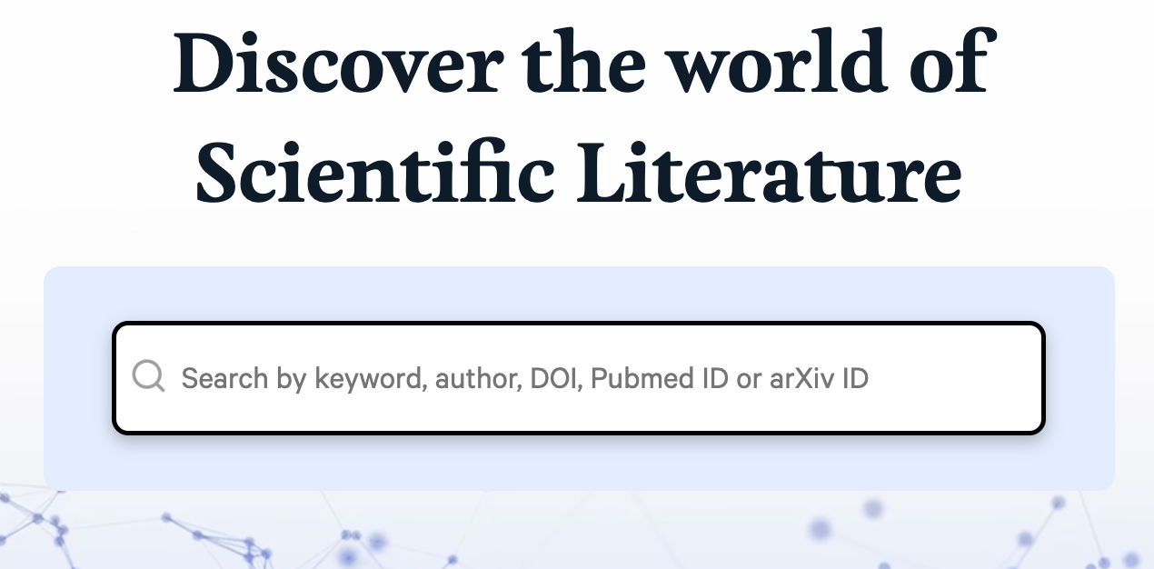
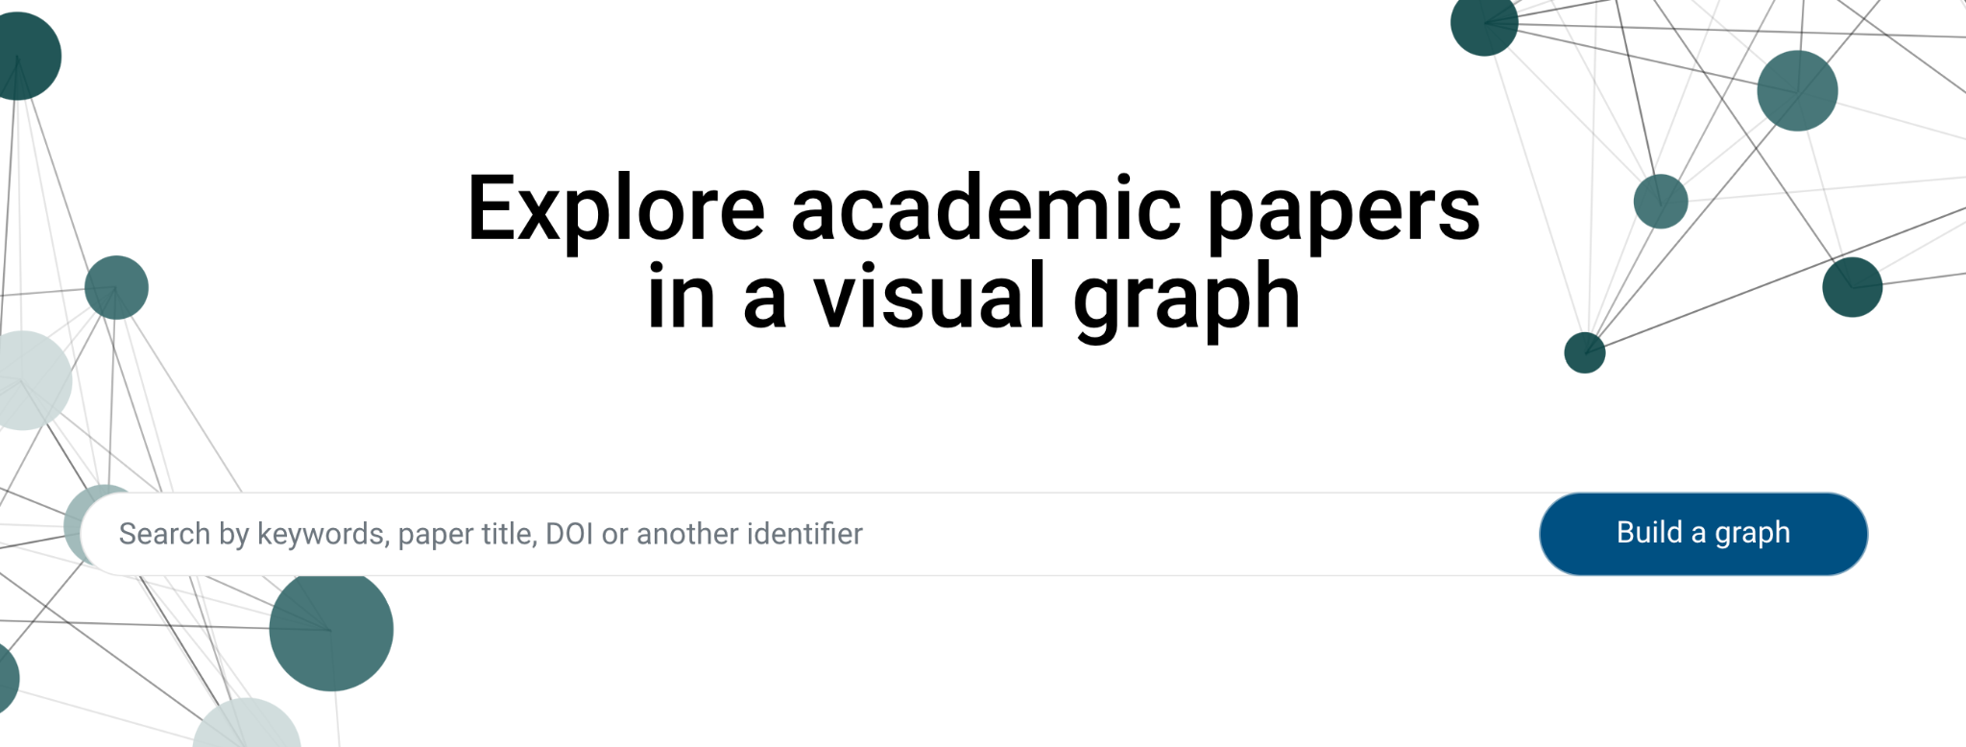


AI tools for Literature Discovery
Notes:
Finally, there are tools that live outside of library databases that are solely for literature discovery (they aren’t chatbots). Several tools do this kind of work: Research Rabbit / Litmaps / ConnectedPapers. I want to be clear: these tools are not necessarily better than just using library databases, but they are new AI tools! They may be fun and engaging!
Alright - so you come to a tool like this that you want to use for lit discovery: Consider, the same questions again:
What can you do for free? What can you do with paid accounts?
Litmaps and ConnectedPapers are both cool but they are really limited unless you have a PAID account
Research Rabbit is FREE so I will focus on that in a moment
What are the data sources the tools are using?
Many of these tools use the semantic scholar corpus, but others may use this and other data sources (scholarly and non)
What other things will this tool do?
Set up alerts?
Add collaborators to collections or folders?
Cite easily by connecting to zotero or another citation manager?
View citation information in different styles (bibtex, major citation formats)?

Slide 27
www.researchrabbit.ai
VIB POLICY
“Do not use for proprietary, confidential, and personal information ”
Notes:
Now it’s time for a deep dive on ResearchRabbit in particular.
RR is a free tool that lets you discover AND visualize literature AND people - they claim it’s like Spotify for research
It lets you create alerts for content
It lets you share collections with collaborators
It integrates with zotero (a free, open source reference manager)
WHAT IS THE CORPUS - not clear. I emailed the RR team and have yet to hear back (but others in library land have also pointed out that it is not clear what the corpus is). It feels like the tool skews to journal articles rather than books and English language content. But it’s unclear what the other elements of the corpus are because they haven’t shared that with us!
The handout has links to step-by-step instructions to get you started with ResearchRabbit, but we will do a hands on demo in a few minutes.

Slide 28
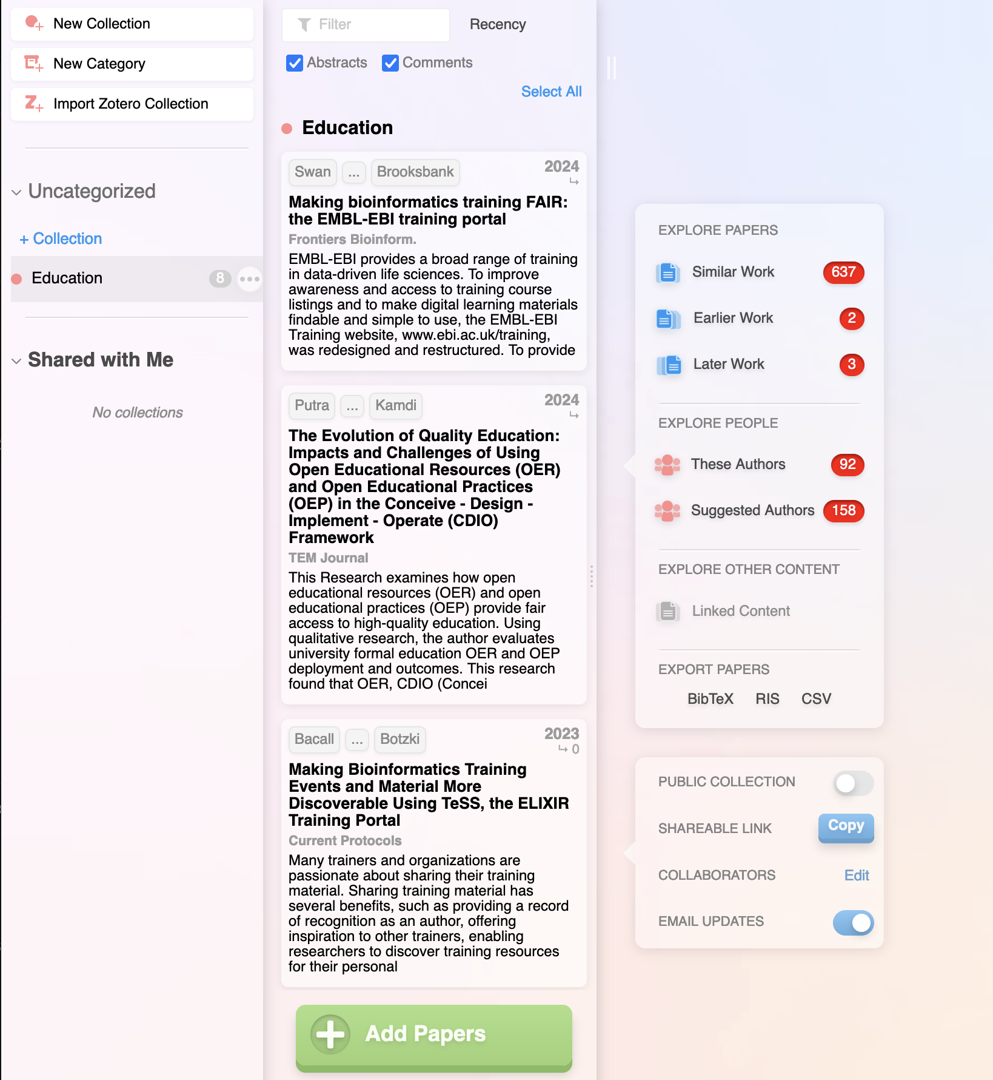
Notes:
Here’s what ResearchRabbit looks like when you get into exploring the tool.
ResearchRabbit uses vertical panels that appear to the right as you click things that expand them.
On the left, you have a dashboard where you can organize research into categories (bold) & collections (with the red dot)
Here I have a collection called Social Work inside a category called
Collections are like folders that can exist within your categories

Slide 29
Notes:
Here’s what ResearchRabbit looks like when you get into exploring the tool.
ResearchRabbit uses vertical panels that appear to the right as you click things that expand them.
On the left, you have a dashboard where you can organize research into categories (bold) & collections (with the red dot)
Here I have a collection called Social Work inside a category called
Collections are like folders that can exist within your categories

Slide 30
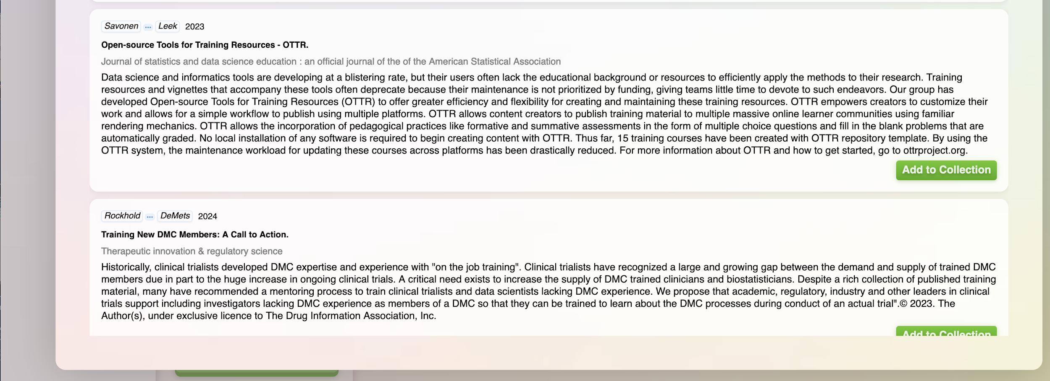
Notes:
Here’s what ResearchRabbit looks like when you get into exploring the tool.
ResearchRabbit uses vertical panels that appear to the right as you click things that expand them.
On the left, you have a dashboard where you can organize research into categories (bold) & collections (with the red dot)
Here I have a collection called Social Work inside a category called
Collections are like folders that can exist within your categories

Slide 31
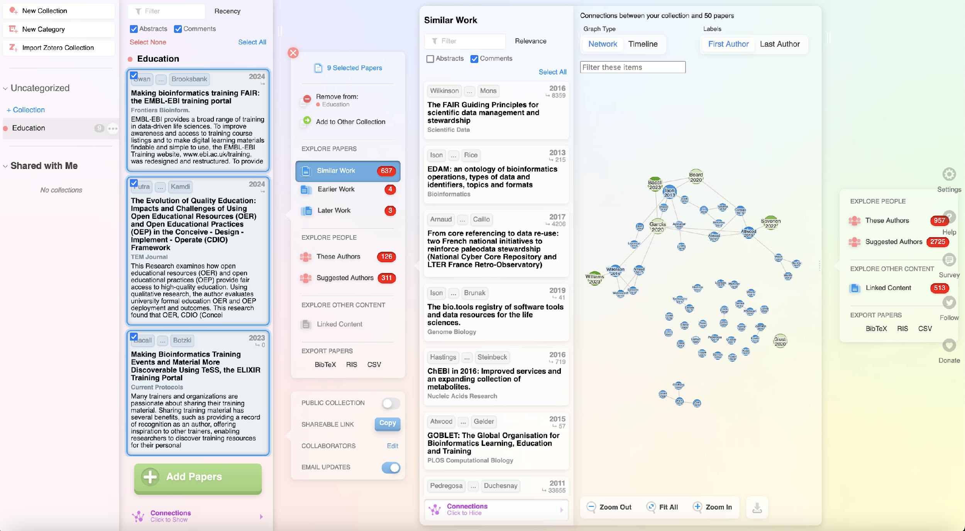

Slide 32
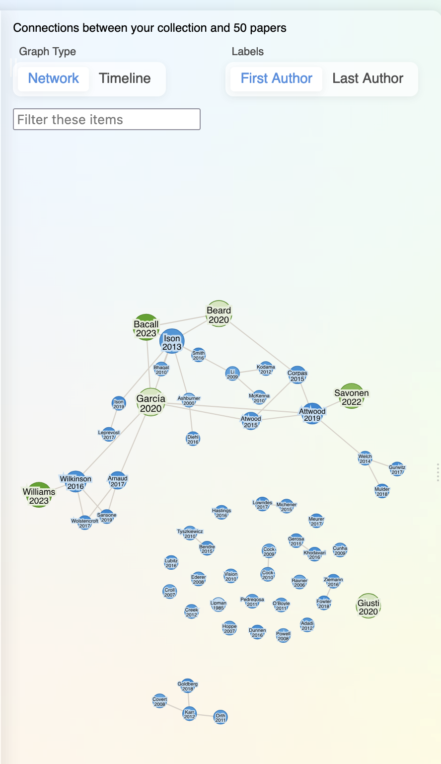
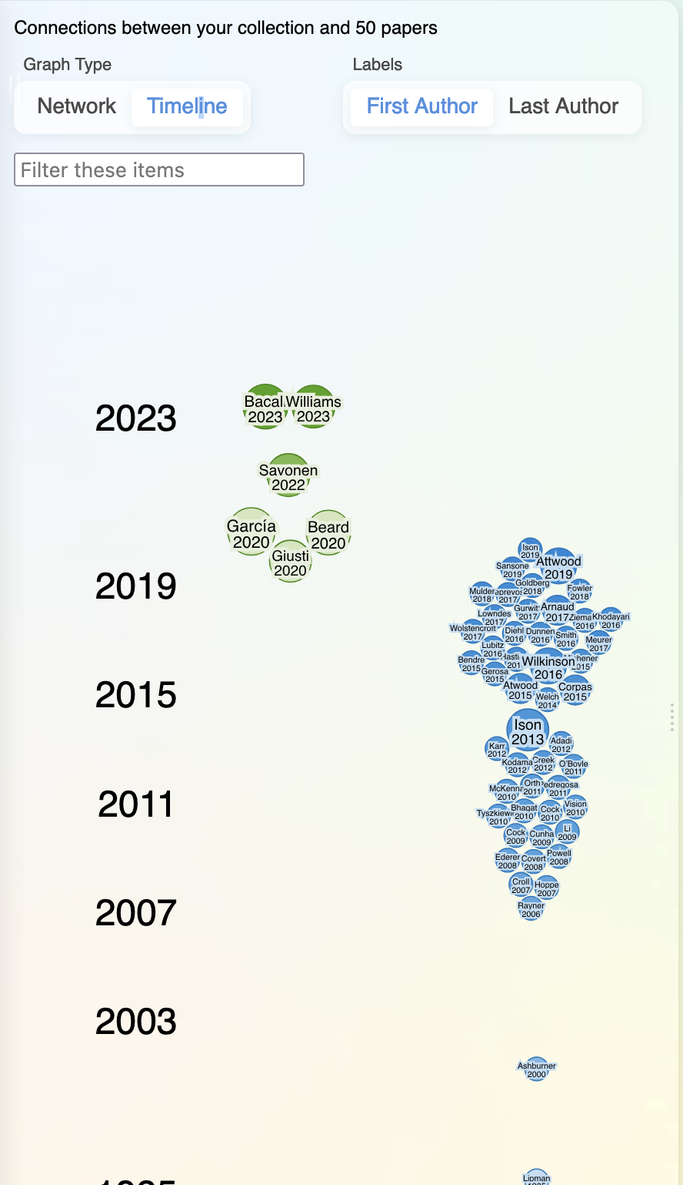
NETWORK VISUALIZATION
TIMELINE VISUALIZATION
Notes:
Once you add several thematically linked papers to a collection, you ask it to find more content (in the context of what else is in the collection)
You can then click on an author or paper and it will find more like whatever you clicked on (based on it and what else is in its network).
Panels just keep opening up as you click on similar work, related authors, particular authors, particular titles etc.
It can definitely be a rabbit hole!

Slide 33
Cool things about Research Rabbit
Free → ostensibly always will be
Useful FAQs
Book 1:1 sessions with them
No issues with hallucinations
No uploading full PDFs, downloading generated content
You can upload Zotero folder of citations & download a RR collection into a Zotero folder
You can export or import .bib or .ris files to Endnote, Zotero & Mendeley
Collections are shareable
Notes:
There are many cool things, in my opinion, about RR:
Free, ostensibly always will be
They have wonderful FAQs
They are very open about letting you book 1:1 sessions with them, especially if you are having trouble connecting your account to zotero {see FAQs} - though recently I went to test this and the calendly link is down… not sure if that’s long term or just a glitch
No issues, so far, with outright hallucinations
No uploading content (like PDFs or secret materials)
It doesn’t generate content that is problematic - no issues there
You CAN upload a Zotero folder of citations and download a research rabbit collection into a zotero folder
You can also export or import .bib or .ris files
You can share individual collections with collaborators
Wrapping up - I will remind you that there are other tools in this space - litmaps is one of them, connected papers is another. But none that I know of are fully free. Still, litmaps, connected papers, and RR and others work roughly the same way, so once you learn RR you could easily hop to other tools and have success navigating those.

Slide 34
Hands-on time — ResearchRabbit.ai
1
─ Create an account + login
─ Create a category
─ Create a collection
─ Add a few citations/papers
─ EXPLORE!
2
3
4
5
Notes:
Okay so let’s dive into Research Rabbit for real! I will demo these steps and you can follow along on your own computers OR just watch my demo. I’ll stick around after this session if anything didn’t work or was weird or if you just want to talk more about RR.
Demo:
Get a log on
Create a category
Create a collection
Add 5 papers
Lncrna & cancer
Show them zotero connection test!
EXPLORE!

Slide 35



Mitigate gaps
AI Research Assistants
Literature databases
Google Scholar
Notes:
https://www.freepik.com/free-vector/robot-doing-repeatable-tasks-with-lot-folders-magnifier-robotic-process-automation-service-robots-profit-automated-processing-concept_11668590.htm#fromView=search&page=1&position=41&uuid=11d7abbf-83e8-4909-be81-65f14a520648
In the quest to mitigate gaps in the literature discovery process, leveraging AI Research Assistants, literature databases like PubMed or library databases, and Google Scholar plays a pivotal role. AI Research Assistants, with their advanced algorithms, can swiftly analyze vast amounts of data, identify relevant studies, and even suggest new research directions, significantly reducing the time researchers spend on manual searches. Literature databases such as PubMed and various library databases offer comprehensive and curated collections of peer-reviewed articles, ensuring that researchers have access to high-quality and reliable sources.
Meanwhile, Google Scholar provides a broad and accessible platform for discovering scholarly articles across disciplines, making it easier for researchers to find pertinent literature and stay updated with the latest advancements in their fields. Together, these tools create a robust framework that enhances the efficiency and effectiveness of the literature discovery process, bridging gaps and fostering a more connected and informed research community.

Slide 36
AI-assisted literature review
Develop a search strategy
Flavors of literature search tools
Screen and triangulate your results
Organize selected literature into a matrix
Analyse to identify patterns & gaps
Synthesise and write
Revise

Slide 37
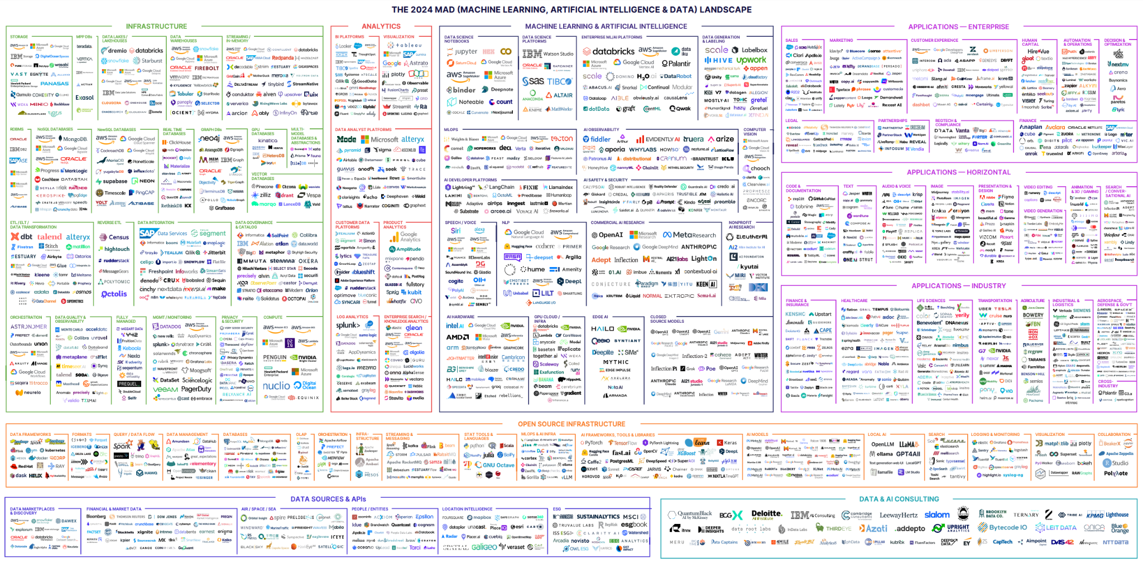
Tools for summarisation
interactive version https://mad.firstmark.com/
Notes:
This diagram is created by an AI specialist named Matt Turk. He has been creating these for about 10 years, and this year’s is especially complex. You are looking at 2,011 companies currently in the Machine Learning, Artificial Intelligence and Data space as of March 31, 2024.
-this is an attempt at a “state of the union” of the aI landscape
-you are not meant to be able to see these icons!
-interactive version https://mad.firstmark.com/

Slide 38
Considerations
Fair use is a legal doctrine that promotes freedom of expression by permitting the unlicensed use of copyright-protected works in certain circumstances… notably … teaching, scholarship, and research.
─ US Copyright Office Fair Use Index
Notes:
Further reading: https://libereurope.eu/wp-content/uploads/2020/09/A-Basic-Guide-to-Limitations-and-Exceptions-in-EU-Copyright-Law-for-Libraries-Educational-and-Research-FINAL-ONLINE-1.pdf
https://lirias.kuleuven.be/retrieve/684849

Slide 39
Check on the policies of the publishers
ASTM International Artificial Intelligence (AI) Policy
ASTM International prohibits the entry of ASTM standards and related ASTM intellectual property (“ASTM IP”) into any form of Artificial Intelligence (AI) tools, such as ChatGPT.
Additionally, creating derivatives of ASTM IP using AI is also prohibited without express written permission from ASTM’s President. In the case of such use, ASTM will suspend a licensee’s access to ASTM IP, and further legal action will be considered.

Slide 40

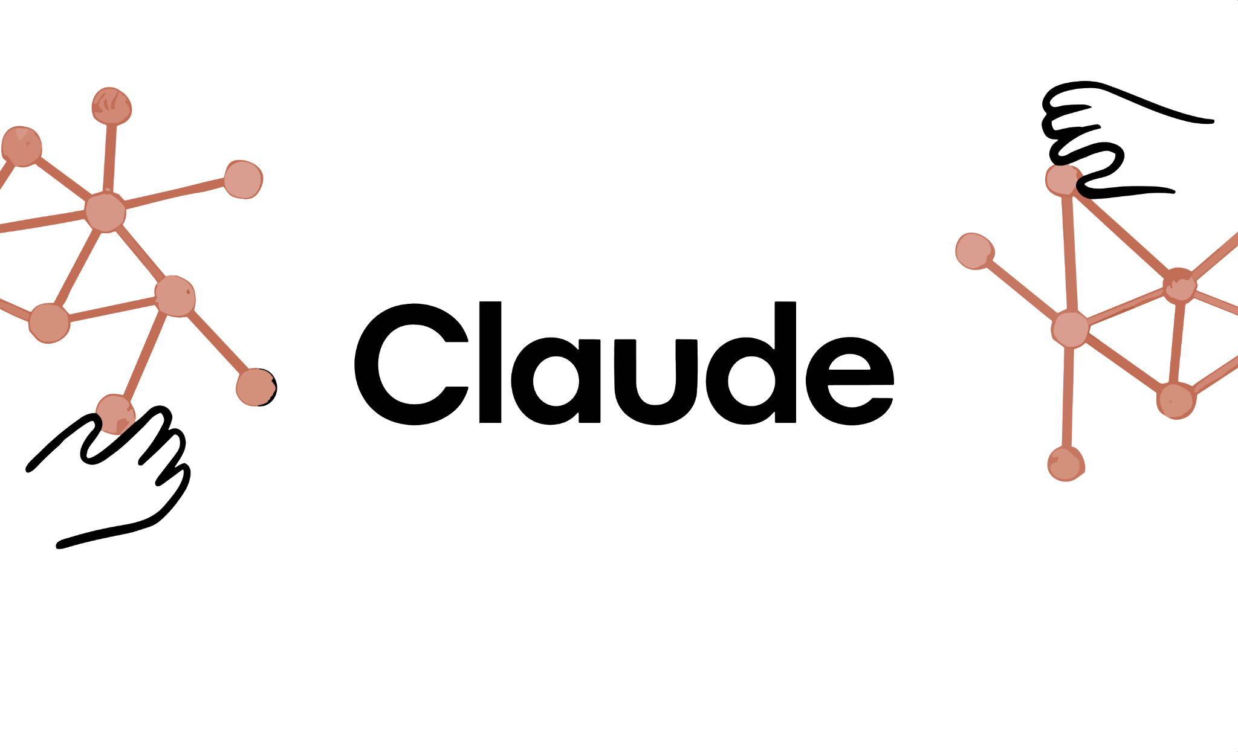



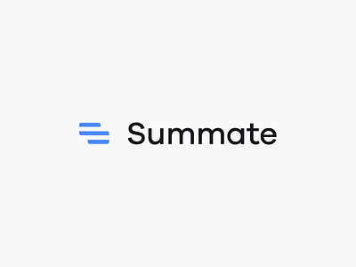









Literature summaries
Notes:
Many tools are suggested as literature summarising tools. Here is a long list of most relevant tools.

Slide 41
Different flavors of summarising tools
AI Literature Discovery
Chatbots
AI on documents
Use their own corpus
(like SemanticScholar)
You upload PDF (or copy-paste)
You upload PDF
Notes:
Elicit, Claude, and Petal are worth to be featured in the course.

Slide 42
https://elicit.com
PRIVACY POLICY
“Any papers you upload to Elicit are private to your account”
VIB POLICY
“Do not use for proprietary, confidential, and personal information ”
Notes:
Elicit is a AI Literature Discovery tool. It finds you research papers from after you ask it a question.
-It is one of the better literature discovery tools out there
Their privacy policy states that ANY PAPERS YOU UPLOAD TO ELICIT ARE PRIVATE TO YOUR ACCOUNT
─all the tools I feature today have policies that explicitly promise not to use your content, since there are some tools that do in fact reuse what you upload
-It’s Model is GPT-3 from ChatGPT fame
-It’s Corpus is Semantic Scholar, which means the papers it finds are real papers and not hallucinations

Slide 43
Short demo: look at an existing notebook
https://elicit.com/notebook/d062b402-32db-4ef2-bdb8-d1e7c5e0804e
Notes:
By using this shared notebook as demo during the course, the main features of Elicit are described.

Slide 44
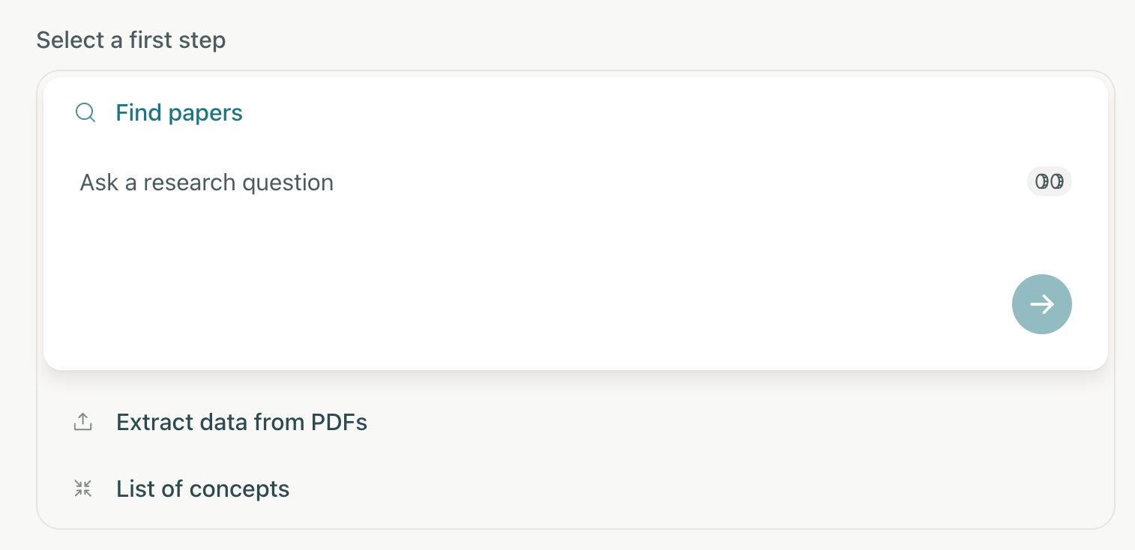
SEARCH
SEMANTIC
SCHOLAR
How to make training events and material more findable, accessible, interoperable and re-usable?
UPLOAD PDF ARTICLE (e.g. via Zotero)
Notes:
-After signing up for an account (or authenticating with google) with Elicit, you will see this on the home screen. Elicit’s homescreen, like all other AI, has changed a bit in the last few months, so if you used Elicit last fall, it might look different. I can only guarantee this is what it looked like last week
CLICK
So how do we get papers into Elicit to summarize? There are two methods, to ask it a question and get a list of papers it deems relevant
-Using the Find Papers box I can type in a research question. this will pull from the corpus SemanticScholar. The cute little coin icon on the right hand side of the search box displays how many credits it costs to run a search. Free accounts have 5,000 credits to use. And clicking around and doing things inside of Elicit costs credits.
CLICK
-The second option is to upload research articles from your computer, which doesn’t cost any credits until you actually try to summarize them.
-the third option is List of Concepts ─ I don’t recommend anyone with a free account attempt this, it can cost up to 2500 credits. This is the most expensive workflow because it often finds dozens of relevant papers, extracts lots of data from each of them, groups the data, and summarizes all of it.

Slide 45
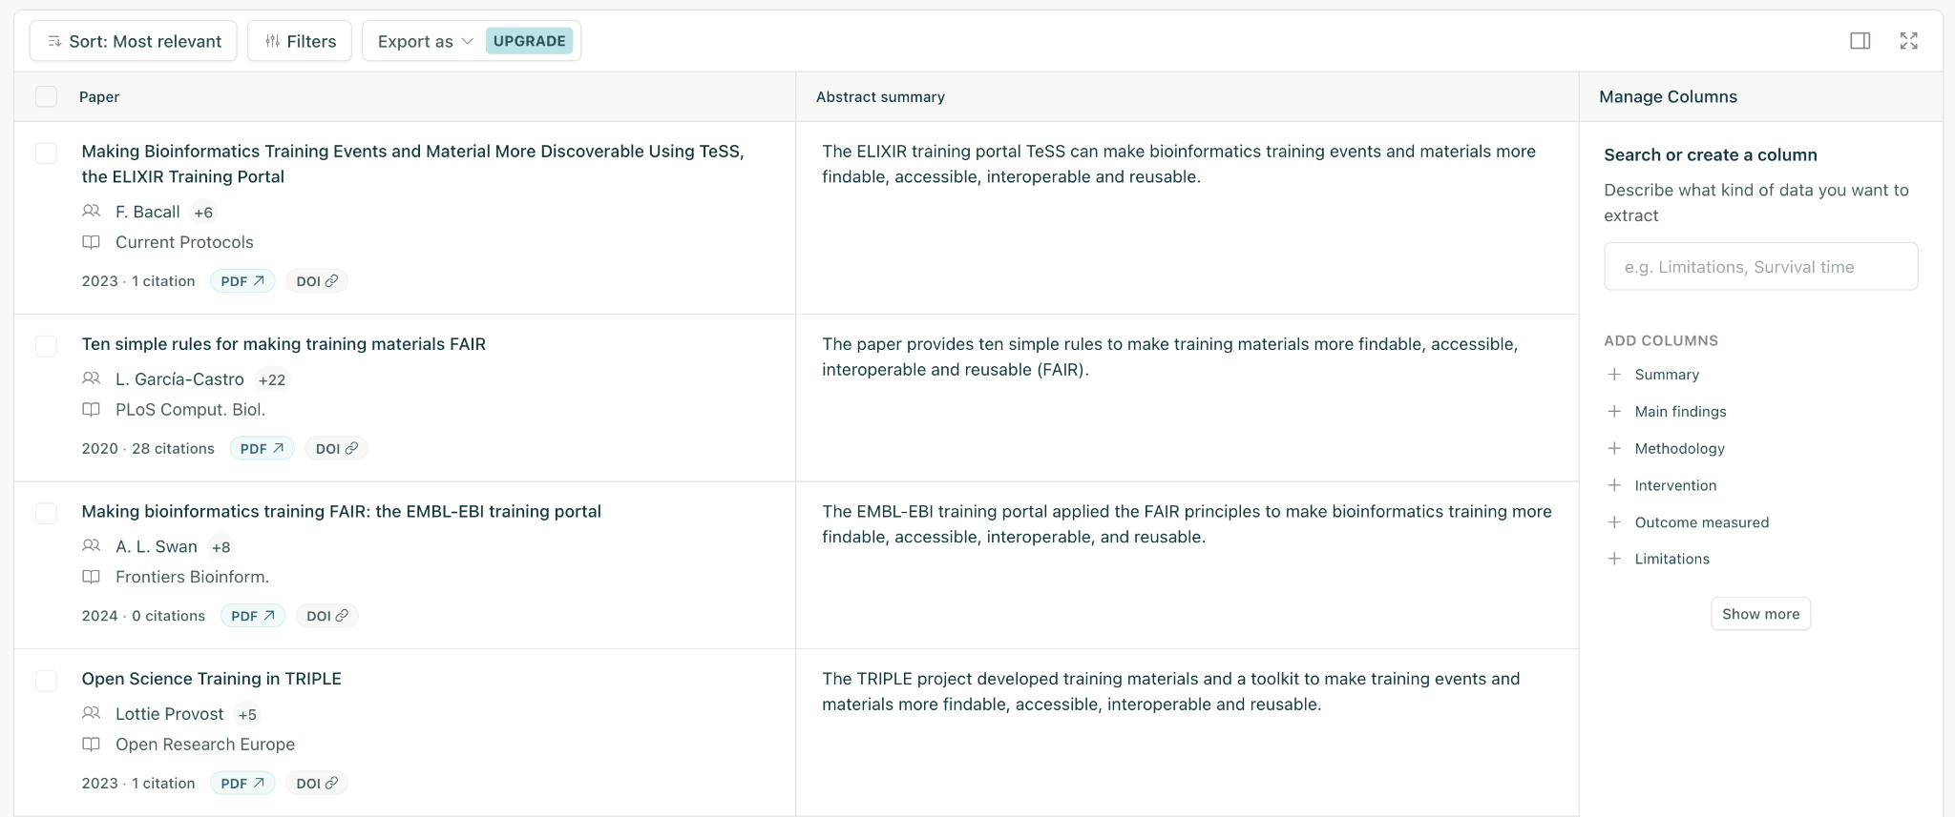
Adding columns for additional aspects about the papers
Notes:
You will get a summary of the top 4 papers (8 in the paying version) as first panel of your answer. For our example the summary is: The papers discuss strategies to make bioinformatics and Open Science training materials more FAIR (Findable, Accessible, Interoperable, Reusable). TeSS, the ELIXIR Training Portal, aggregates training resources using Bioschemas specifications, enhancing discoverability (Bacall et al., 2023). The EMBL-EBI Training website applies FAIR principles to course listings and digital learning materials, improving accessibility and user experience (Swan et al., 2024). Ten simple rules for making training materials FAIR have been proposed to address the challenge of finding and repurposing existing materials (García-Castro et al., 2020). The TRIPLE project developed an Open Science training series and a Training Toolkit to support SSH researchers and trainers in implementing FAIR practices (Provost et al., 2023). These initiatives aim to increase the visibility, accessibility, and reusability of training resources, ultimately improving the training landscape in bioinformatics and related fields.
How do we set up our table? How do we identify the columns?
I use the Column options on the right hand side of my screen to set up my table. The Citation information and Abstract of the article will alway be visible, and the rest I can customize
-clicking the plus button will add the column to your table
-here I have added Summary and Main Finding

Slide 46
Beyond ‘Summary’ and ‘Main Finding’ you have many more parameters
Methodology | Summary of intro | Research gaps | Study count | Duration | Population characteristics
Intervention | Summary of discussion | Hypotheses tested | Independent variables | Statistical techniques | Participant age
Outcome | Study design | Future research | Dependent variables | Algorithms | Population sex
Limitations | Theoretical framework | Funding source | Measured variables | Software | Organism
Intervention effects | Research question | Dataset | Region | Participant count | Policy recommendations
Notes:
This is the overview of the many parameters Elicit provides to add to the standard fields (parameters) Summary and ‘Main Finding’. As such, each paper can be screened regarding many dimensions and a comprehensive matrix of the selected articles can be created.

Slide 47
Elicit - Pros and Cons
a versatile and adaptable tool
integrates with Zotero
Supports bulk upload of PDFs
capable of summarizing multiple papers
promises PDF privacy
Offers multi-dimensional analysis with the paid version
Export functionality requires the Plus version
Most interactions require credits
some aspects lack transparency
Notes:
Incredibly flexible + customizable tool
Built on the Semantic Scholar corpus
Free version: one-time 5,000 credit allotment (~380 summaries)
Paid version is affordable if you go for a monthly subscription and cancel

Slide 48
https://claude.ai
PRIVACY POLICY
“We will not use your Inputs or Outputs to train our models”
VIB POLICY
“Currently under review ”
Notes:
Claude is the name of the chatbot from the company Anthropic, which was started by seven former members of OpenAI.
Their newest model was released only last month
Model - Claude 3 Sonnet
Corpus - “the collected corpus of human knowledge” and of course whatever PDFs we give it directly
Chatbot similar to chatGPT, easy to use
Allows copy-pasting/uploading of long articles to get summaries
Free & Pro version
Pro: very generous usage free plan
- by default does not use data to train their models
- Claude has a very friendly personality
Cons: cannot handle more than 1-2 articles simultaneously very well
- free version will eventually limit (~8 summaries in 4 hrs), refreshes every morning

Slide 49
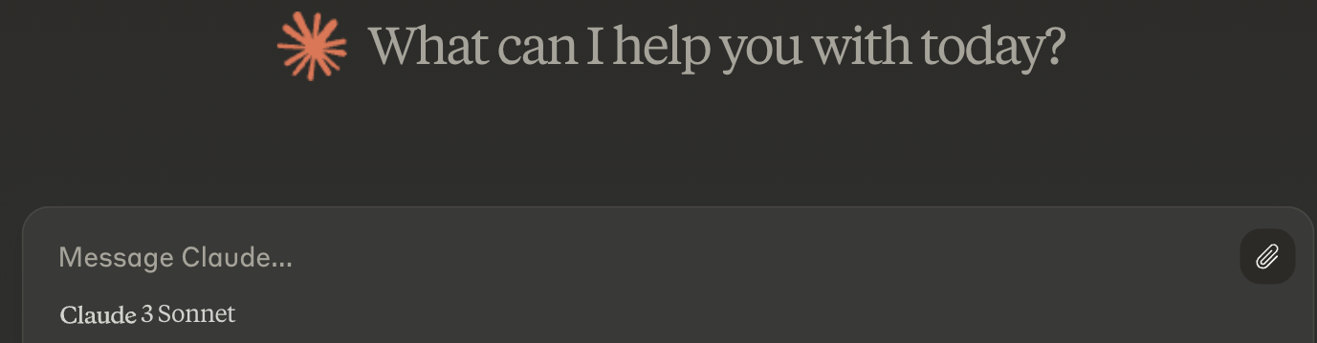
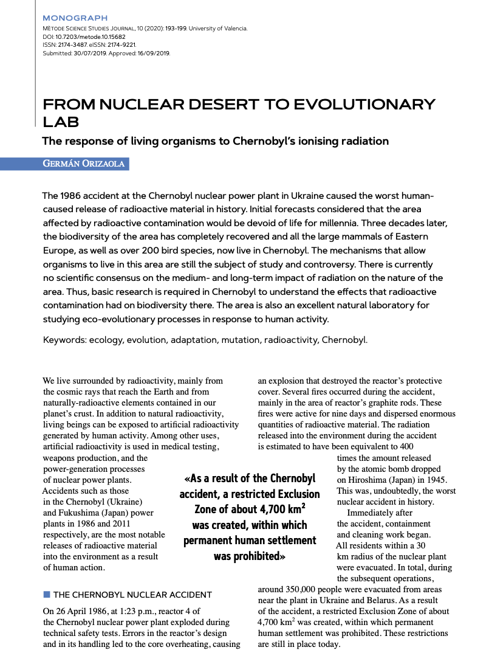

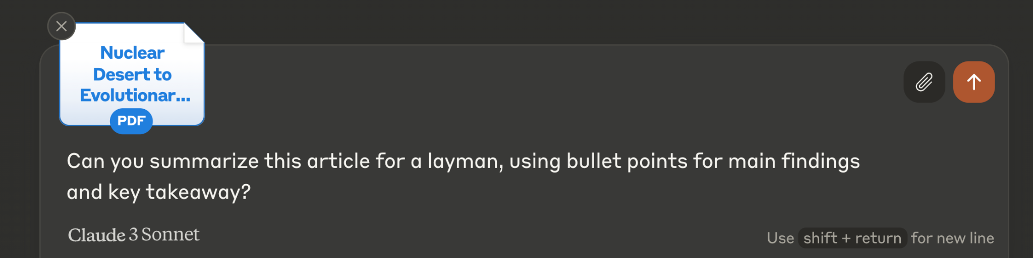
s?
Orizaola, Germán. "From Nuclear Desert to Evolutionary Lab: The Response of Living Organisms to Chernobyl's Ionising Radiation." Mètode Science Studies Journal, vol. 10, 2020, pp. 193-199. doi:10.7203/metode.10.15682
Notes:
After signing up for an account with Claude (or authenticating with Google) you can upload an academic article directly using the paperclip icon
-claude says it allows up to 5 documents of 10 megabytes each, which is about 100 or so pages
-when working with articles I have only been able to upload two and still get Claude to speak to me
-for our purposes I have chosen this article about animals living in the exclusion zone around the chernobyl nuclear power plant, and uploaded the PDF from my computer
-you can also copy-paste an entire article, but when I do this I tend to leave off the references pages

Slide 50
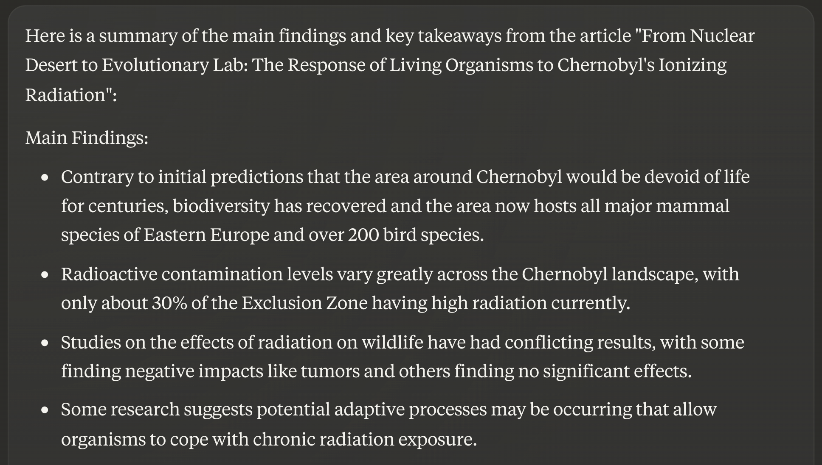
Notes:
After signing up for an account with Claude (or authenticating with Google) you can upload an academic article directly using the paperclip icon
-claude says it allows up to 5 documents of 10 megabytes each, which is about 100 or so pages
-when working with articles I have only been able to upload two and still get Claude to speak to me
-for our purposes I have chosen this article about animals living in the exclusion zone around the chernobyl nuclear power plant, and uploaded the PDF from my computer
-you can also copy-paste an entire article, but when I do this I tend to leave off the references pages

Slide 51
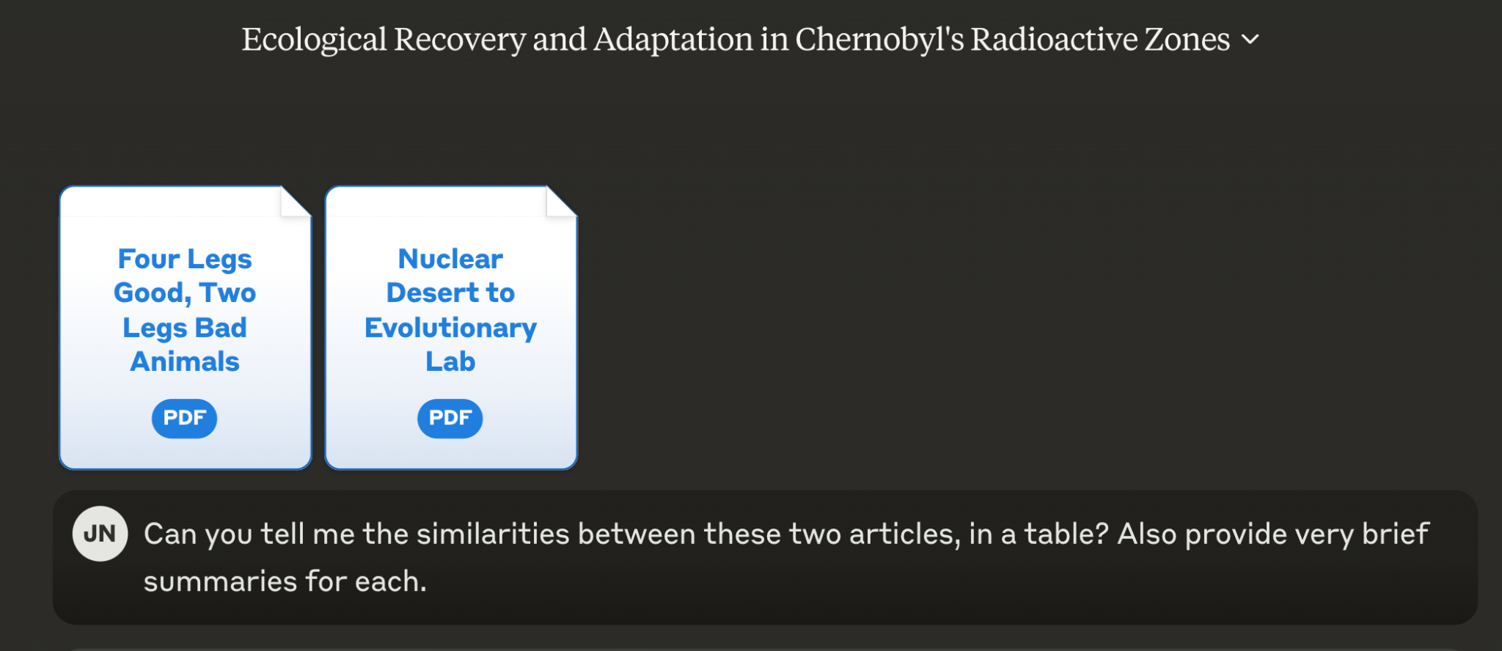
CHAT SESSION TITLE
Notes:
After signing up for an account with Claude (or authenticating with Google) you can upload an academic article directly using the paperclip icon
-claude says it allows up to 5 documents of 10 megabytes each, which is about 100 or so pages
-when working with articles I have only been able to upload two and still get Claude to speak to me
-for our purposes I have chosen this article about animals living in the exclusion zone around the chernobyl nuclear power plant, and uploaded the PDF from my computer
-you can also copy-paste an entire article, but when I do this I tend to leave off the references pages

Slide 52
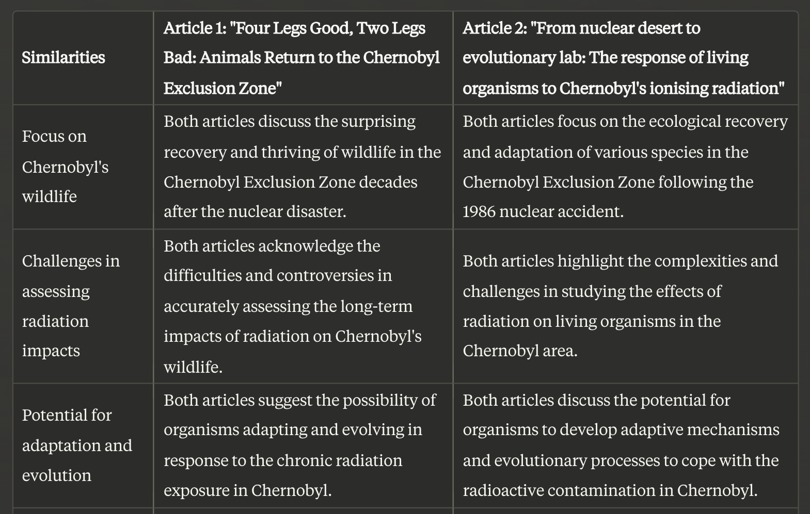
Notes:
After signing up for an account with Claude (or authenticating with Google) you can upload an academic article directly using the paperclip icon
-claude says it allows up to 5 documents of 10 megabytes each, which is about 100 or so pages
-when working with articles I have only been able to upload two and still get Claude to speak to me
-for our purposes I have chosen this article about animals living in the exclusion zone around the chernobyl nuclear power plant, and uploaded the PDF from my computer
-you can also copy-paste an entire article, but when I do this I tend to leave off the references pages

Slide 53
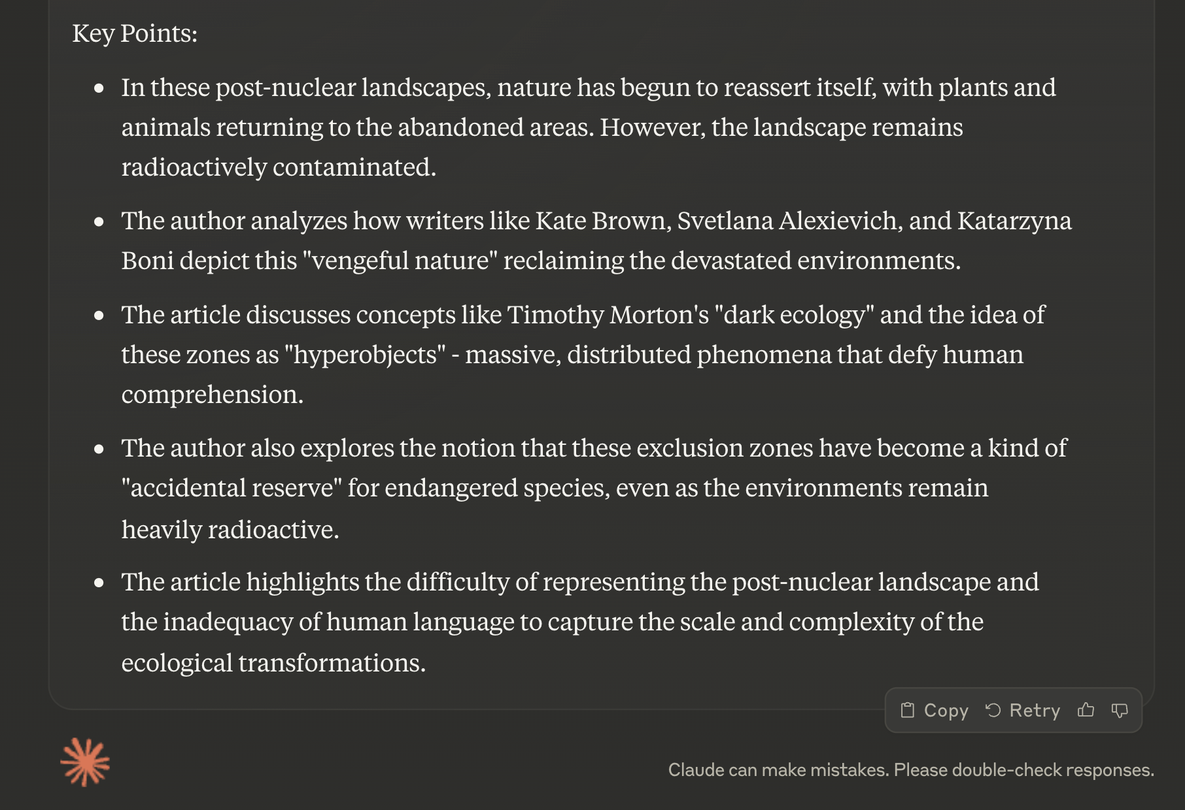
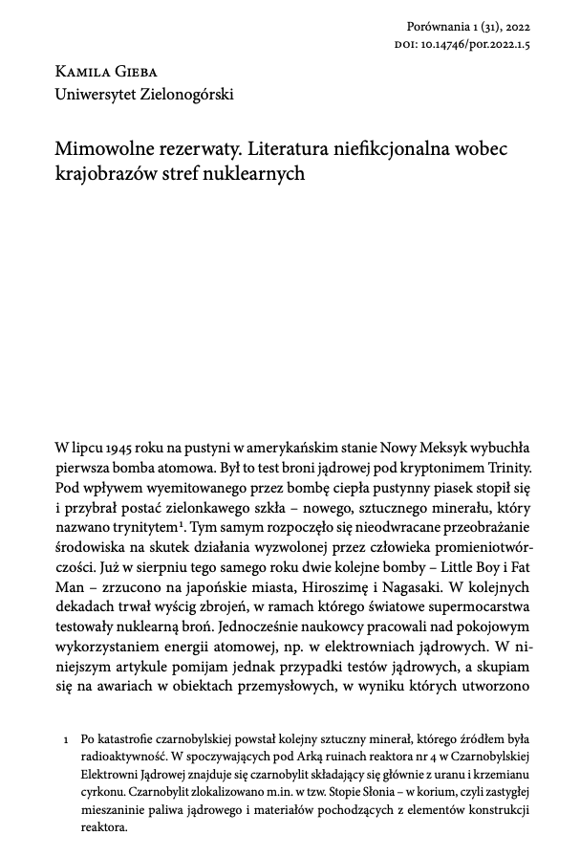
Notes:
And finally one great feature of Claude is that it can handle multiple languages.
- in one of the survey questions someone asked how these tools dealt with translation and languages.
- for a text I upload a Polish article about the exclusion zones to claude, and asked for a simple summary in English
- we could not confirm the accuracy of the rest of the summary, but for those of you who find research that only exists in a language you do not speak, this might be a way determine the broad outlines of an article and if further translation services are necessary
- on the language issue, most AI chatbots like chatGPT and Claude can understand most major european languages, including mandarin chinese, russian, and arabic in their input boxes
- we encourage those of you who speak another language to test Claude

Slide 54

www.petal.org
Let’s work on an example together
Get/download a PDF of your choice with CC-BY license e.g. after publication or from Biorxiv
PRIVACY POLICY
“We do not currently use user-uploaded data for training purposes, either internally or externally with OpenAI. Other users are not able to access uploaded data without the explicit consent of the original uploader.”
VIB POLICY
“Not officially screened but do not use for proprietary, confidential, and personal information ”
Notes:
Petal is a document analysis tool.
Model - GPT 3
Corpus - whatever PDFs you upload
Professors et al
Et al = et alia = and others

Slide 55
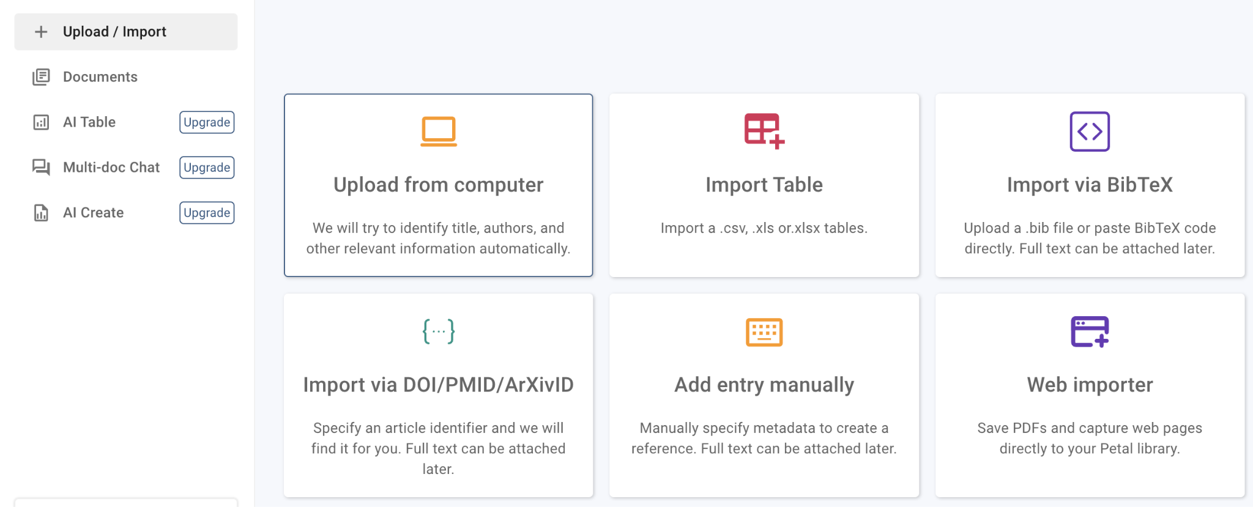
Notes:
After signing up with an email and password (or authenticating through Google) Petal’s dashboard looks like this
-to summarize an article, use the Upload from Computer tile and choose your article
I don’t recommend using the Import via DOI box because the article metadata will come through but not the full text

Slide 56
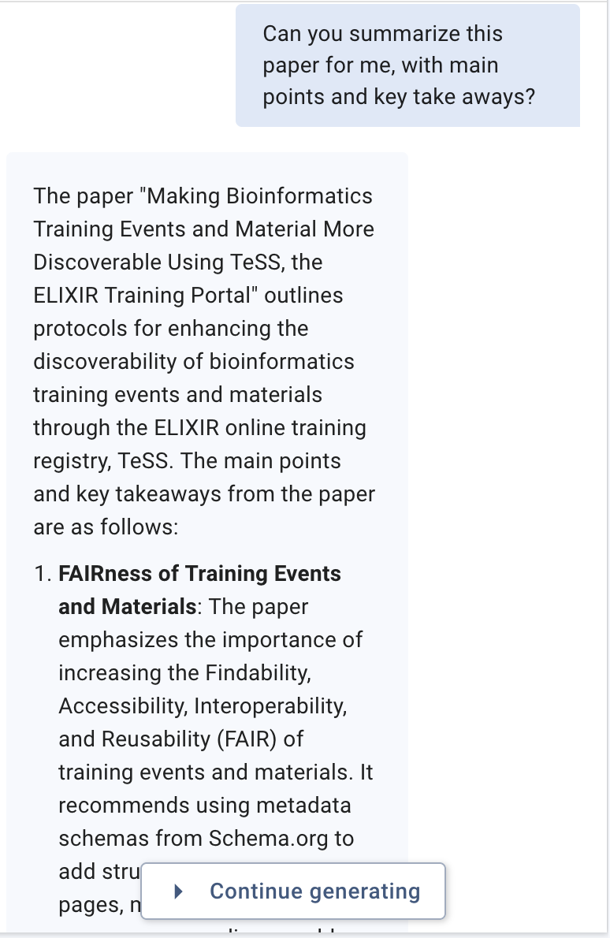
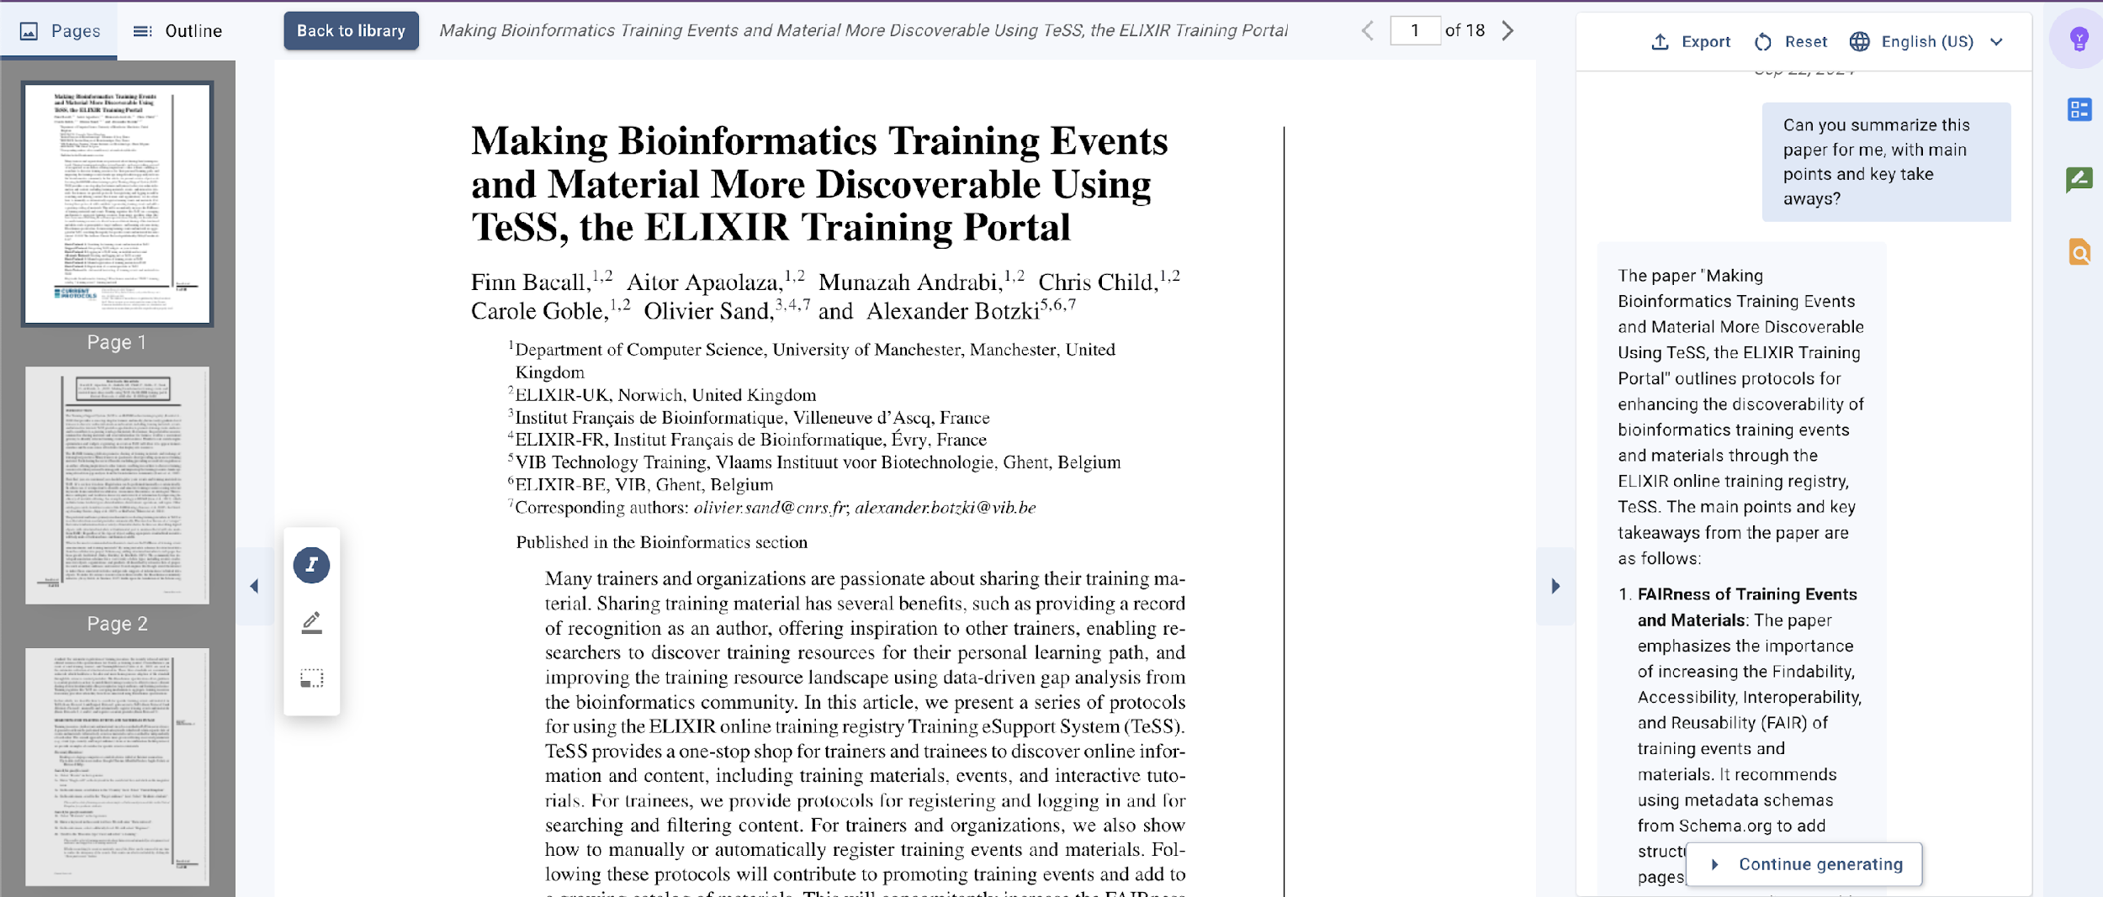
Notes:
-The PDF you uploaded will display in a large window on the left
-you can chat with the PDF on the right hand side of the page, with the chat window at the bottom
-here we have asked Petal to summarize my document on training material. Question: Can you summarise the paper for me, with main points and key takeaways?
-here is a close up view of the summary, it extends below this image
-there’s no way to set up the Petal dashboard differently that I can find, so there ends up being a lot of scrolling
-inside of the summaries or any questions Petal answers are citations to where in the article the information was found

Slide 57
PROMPT
How is the FAIRness of training material measured?
The FAIRness of training material is measured by the extent to which the material complies with the FAIR principles, which stand for Findable, Accessible, Interoperable, and Reusable. The paper emphasizes the importance of increasing the FAIRness of training materials to make life science resources more discoverable [1.1].
It suggests that adding structured metadata to web pages using metadata schemas for structured data from the collaborative project Schema.org greatly facilitates the process of making training events and materials more FAIR [1.2].
Furthermore, the paper highlights the use of Bioschemas specifications to enrich training resources, allowing for more efficient sharing of structured metadata like prerequisites, target audience, and learning outcomes, which contributes to the FAIRness of the materials [1.3].
If you need further details on the specific metrics used to measure FAIRness, the paper does not explicitly mention them.
Notes:
Since the article is an article we have written, it is quite easy to evaluate the accuracy of the tool in summarising the points and the follow-up question. Highlighted in yellow, you see that the tool rightfully mentions that explicit metrics how to measure FAIRness are not mentioned in the article.

Slide 58
PROMPT
How can you implement the Bioschemas annotation for training events?
You can implement the Bioschemas annotation for training events by manually or automatically registering training resources in the ELIXIR Training eSupport System (TeSS). The paper provides detailed protocols for both methods. For manual registration, it is important to describe and annotate training resources using relevant controlled vocabularies, taxonomies, thesauruses, or ontologies to reduce ambiguity and facilitate discovery and retrieval of information [1.1]. For automatic registration, the paper recommends using the recently released specifications for Course, CourseInstance, and TrainingMaterial to collect structured metadata, which are community-endorsed standards used in the automatic collection of training resources [1.2]. These standards offer guidance to content providers on how to enrich their training resources to allow for more efficient sharing of structured metadata like prerequisites, target audience, and learning outcomes [1.2].

Slide 59

HITL Writing – “AI” sandwich with human quality control
AI Exploration
Human Drafting
AI supports feedback
Human QC
Notes:
Human-in-the-loop writing, often visualized as an “AI sandwich,” integrates both artificial intelligence and human expertise to enhance the writing process. This approach begins with AI exploration, where advanced tools assist in gathering information, generating ideas, and outlining initial concepts. The main ingredient of the process is human drafting, where writers bring their creativity, critical thinking, and subject matter expertise to craft the core content. Following this, AI-supported feedback provides valuable insights, suggesting improvements in structure, style, and coherence. Finally, the process is completed with human quality control, where proofreading ensures the highest standards of accuracy, clarity, and overall quality. This collaborative method leverages the strengths of both AI and human capabilities, resulting in well-rounded, polished, and impactful written work.

Slide 60
Story telling – write and illustrate an article
The qualities of a good research report
The preliminary phase: purpose, audience and contents
Structuring a research report
Parts of a research report
Proposal writing
Writing the research report of proposal
Visual appearance
Academic posters
We recommend our courses on Scientific writing Show don't tell Gimp and Inkscape

Slide 61
Catchy titles for your grant, figure or slide
☑ An active title for your grant, your figure, your slide
Please now come up with five different titles for this project. Please consider the audience and make the titles in the structure of "SUBJECT VERB OBJECT". The subject should be the most important element of the project, something that is unique to this project. The verb should be in ACTIVE form, i.e. the title should be a statement, and be as specific as possible. Please provide five titles that are as diverse as possible so that we have a range to choose from. 1.Express only one idea or subject in your title.
2.Put an important word first in the title.
3.The title should be a statement, i.e. include a verb.
4.A title should be the fewest possible words that accurately describe the content of the paper (the recommended length is 10 - 12 words).
5.Use simple word orders and common word combinations.
6.Be as descriptive as possible and use specific rather than general terms (specific drug name rather than just the class of drug).
7.Write names in full, avoid using abbreviations and acronyms.
8.Use key words which highlight the main content of your manuscript and can be understood, indexed, and retrieved by a database search.
Notes:
Exercise https://docs.google.com/document/d/1lpKvjP_Ez4O8HdxH20AJzkLTVFgwxk_U/edit

Slide 62
Feedback on your drafts
Flow-level details (check on approaches)
Structure and organization
Coherence and cohesion
Argumentation and support
Integration of research
Accuracy-level details (Grammarly)
Grammar and syntax
Punctuation and spelling
Word choice
Formatting and style

Slide 63
Feedback on your drafts
The MEAL Plan is a structured approach to writing and feedback that stands for:
Main Idea: The central argument or point of the paragraph.
Evidence: Supporting details, facts, or data that back up the main idea.
Analysis: Explanation of how the evidence supports the main idea.
Link: Connection to the next paragraph or overall thesis.
Notes:
https://scientistseessquirrel.wordpress.com/2023/06/20/how-to-use-chatgpt-in-scientific-writing/
Readme about MEAL: https://twp.duke.edu/sites/twp.duke.edu/files/file-attachments/meal-plan.original.pdf Prompt
Create feedback according to this writing exercise following the MEAL Plan feedback scheme. Work stepwise. First create a quick recap of the MEAL Plan feedback scheme. Second, create a summary of the assessment results as detailed in the third step. Third give detailed constructive feedback on the second paragraph of the text fragment below. Use a table with four columns. The first column is the trimmed sentence you identified based on the MEAL plan, second colum is the MEAL plan category, third is a checkbox yes (draft a green mark)/no (draw a red exclamation mark) on the evidence of the MEAL category, fourth column is a brief explanation/suggestion for revision. In the fourth column, comment on the respective intension of the MEAL category and how this is applied. Don't repeat the intension.
Text fragment: Gunderson et al, define four types of reproducibility based on the quality of the documentation (Gundersen and Kjensmo, 2018). The lowest degree of reproducibility is “R1 description” that encompasses a textual description of the experiment. “R2 code” contains the code/workflow and its associated metadata but lacks the original data. “R3 data” refers to the available dataset and the associated metadata without the workflow for creating the metadata. “R4 experiments” is the highest degree of reproducibility with dataset, code and associated documentation. Addressing reproducibility via documentation inspired multiple initiatives within the field and beyond. These initiatives attempt to standardize the documentation that accompanies the generation of a bioimaging dataset—and by extension other data analysis disciplines. Organizations such as EOSC assert that the quality of data and associated metadata will improve/if it is Findable, Accessible Interoperable, and Reusable (FAIR; Wilkinson et al, 2016), and will enhance the reproducibility of research (https://zenodo.org/records/7515816). The FAIRification of data requires work at many levels from ontology to reproducible analysis pipelines. Recent ontologies such as REMBI (Sarkans et al, 2021), MITI (Schapiro et al, 2022), and EDAM Bioimaging (https://bioportal.bioontology.org/ontologies/EDAM-BIOIMAGING) provide a starting point to report metadata associated with analysis. The typical and most common tool for documenting experiments is the electronic labnotebook (Myers et al, 2001), which does not necessarily accommodate the aforementioned standardization of metadata like REMBI, MITI or EDAM. These metadata standards are increasingly incorporated with rich file formats (like OME-TIFF and OME -Zarr) or data tools such as OMERO to find and browse images alongside metadata; https://www.openmicroscopy.org/omero/) and ManGO for associating any file with predetermined metadata on modern data management systems like iRODS (https://irods.org/; https://github.com/kuleuven/mango-metadata-schemas).
Results:
MEAL Plan Feedback Scheme Recap
The MEAL Plan is a structured approach to writing and feedback that stands for:
Main Idea: The central argument or point of the paragraph.
Evidence: Supporting details, facts, or data that back up the main idea.
Analysis: Explanation of how the evidence supports the main idea.
Link: Connection to the next paragraph or overall thesis.
Summary of Assessment Results
The second paragraph discusses initiatives inspired by the need for reproducibility in documentation, focusing on standardization efforts and the FAIR principles. The paragraph is informative but could benefit from clearer connections between ideas and more explicit analysis.
Detailed Constructive Feedback
Trimmed Sentence MEAL Plan Category Evidence (Yes/No) Explanation/Suggestion for Revision Addressing reproducibility via documentation inspired multiple initiatives within the field and beyond. Main Idea !green mark This sentence introduces the main idea of the paragraph. It could be more specific about what these initiatives are. These initiatives attempt to standardize the documentation that accompanies the generation of a bioimaging dataset—and by extension other data analysis disciplines. Evidence !green mark This provides evidence of the initiatives’ goals. It would be stronger with specific examples of initiatives. Organizations such as EOSC assert that the quality of data and associated metadata will improve/if it is Findable, Accessible Interoperable, and Reusable (FAIR; Wilkinson et al, 2016), and will enhance the reproducibility of research (https://zenodo.org/records/7515816). Evidence !green mark This sentence gives specific evidence supporting the main idea. Ensure the citation format is consistent and consider explaining the FAIR principles briefly. The FAIRification of data requires work at many levels from ontology to reproducible analysis pipelines. Analysis !green mark This sentence begins to analyze the implications of the FAIR principles. It could be expanded to explain why these levels are important. Recent ontologies such as REMBI (Sarkans et al, 2021), MITI (Schapiro et al, 2022), and EDAM Bioimaging (https://bioportal.bioontology.org/ontologies/EDAM-BIOIMAGING) provide a starting point to report metadata associated with analysis. Evidence !green mark This provides further evidence with specific examples. It would benefit from a brief explanation of what these ontologies are and how they contribute to reproducibility. The paragraph could benefit from a concluding sentence that links back to the overall thesis or transitions to the next paragraph. Link !red exclamation mark Adding a concluding sentence would help tie the paragraph back to the main argument and provide a smoother transition to the next section. Would you like to proceed with feedback on the next paragraph or need any further assistance?

Slide 64
Abstracts
If you use GenAI to edit the style, tone, or format of your drafts:
Consult specific journal, publisher, or funder guidelines
Be prepared to describe in Acknowledgments or Methods section
Save your original draft, prompts, and AI outputs
Notes:
So beyond the question of AI and authorship, let's talk through some of the other scenarios researchers may use AI in the writing process. First off, we'll look at using GenAI to shape the style, tone, or formatting of your drafts.
Compared to the question of authorship, when it comes to using AI as a research or writing assistant, guidelines tend to vary a little in how this kind of use should be acknowledged and described.
For example, most publisher and journal policies allow for AI tools to be used for research and writing assistants, as long as you are transparent about your use. But "transparent" can vary, from describing your use of AI tools in your submission cover letter, your Methods or Acknowledgements sections, or sharing more extensive details as an Appendix to your paper.
On the other end of the spectrum, the STM Association only requires disclosing AI use if it goes beyond "basic author support," which they define as functions like refining, correcting, and editing drafts.
So, the more you plan for transparency from the outset of your project, the better positioned you will be to be able to meet specific journal, publisher, or funder policies.

Slide 65
Graphical abstracts
☑ Graphical Abstract Optimization Prompt
"I am working on a scientific graphical abstract and need your expertise as a senior scientist with extensive experience in enhancing the intuitiveness of such visuals. Begin by providing an initial assessment of the current strengths and weaknesses of the graphical abstract. Then ask me which specific elements of the schematic I am most concerned about improving. Then, Analyze the layout and offer step-by-step guidance on how to optimize the positioning of objects, visual clustering of related elements, and separation of unrelated elements. Provide specific advice on creating a visual storyline that efficiently communicates the scientific message from start to finish. Consider the use of colors to link related data and differentiate distinct data groups. I will upload the schematic; ensure your suggestions are tailored precisely to it and avoid generic advice. Guide me through each step, focusing on meta-level improvements to ensure the message is as clear as possible. Please take a deep breath, think deeply and intensely and do this step by step.
Example https://wires.onlinelibrary.wiley.com/doi/full/10.1002/widm.1550
Notes:
See https://docs.google.com/document/d/1lpKvjP_Ez4O8HdxH20AJzkLTVFgwxk_U/edit#heading=h.56fy8utg3z99

Slide 66
Graphics – mindmaps from PDFs
1. Upload the PDF downloaded from https://doi.org/10.1080/02602938.2024.2386662 to Claude.
2. create a Mermaid code visual based on the themes addressed in the attached article. 3. Copy the resulting code to https://mermaid.live/edit
Based on: https://aivoorstudenten.be/en/courses/ai-voor-studenten/lessons/visualiseren/
Notes:
graph TD
A[Assessment in Higher Education]
B[Traditional Focus on Cheating]
C[Proposed Focus on Validity]
D[Problems with Cheating-Centric Approach]
E[Benefits of Validity-Centric Approach]
F[Implications for Practice]
A --> B
A --> C
B --> D
C --> E
D --> F
E --> F
B --> |Leads to| B1[Moralistic Judgments]
B --> |Results in| B2[Punitive Measures]
B --> |Focuses on| B3[Rule Adherence]
C --> |Emphasizes| C1[Assurance of Learning]
C --> |Considers| C2[Consequential Validity]
C --> |Views Cheating as| C3[Subset of Validity Issues]
D --> D1[Neglects Broader Educational Issues]
D --> D2[May Harm Student Learning]
D --> D3[Lacks Evidence of Efficacy]
E --> E1[Holistic Approach to Assessment]
E --> E2[Focuses on Capability Demonstration]
E --> E3[Addresses New Challenges More Effectively]
F --> F1[Redesign Assessments for Validity]
F --> F2[Shift from Punishment to Learning Support]
F --> F3[Balance Security with Inclusion]

Slide 67
Dealing with Data

Slide 68
Quantitative Research
https://github.com/vibbits/introduction-to-generative-ai.git
We use https://posit.cloud
We work in groups of 3-4 persons

Slide 69
Data Set for Today
The Excel file is in the folder exercises of the github repo.
Order ID: Order you signed up
Sold on: When you signed up
Role: What you said you were [recoded] MailingList: Are you on it? [created]

Slide 70
Let’s get started!
First: how does RStudio know where your files are?
Let’s ask something like: “How do I tell RStudio where it can find my files?”
Notes:
RStudio uses a concept called the working directory to locate your files. Here are a few key points on how it works:
RStudio Projects: When you create or open an RStudio project, it sets the working directory to the folder where the project file (with the extension .Rproj) is located. This makes file paths relative to the project directory, which helps in managing file paths more effectively¹.
Setting the Working Directory: You can manually set the working directory in RStudio by using the menu option Session > Set Working Directory > Choose Directory... or by using the command setwd("path/to/your/directory") in the console².
Default Directory: If you don’t set a working directory, RStudio will use the default directory, which is usually your home directory or the directory where RStudio was launched³.
File Associations: RStudio can also open files directly from your system’s file browser. When you open a file this way, RStudio sets the working directory to the location of that file²

Slide 71
Let’s get started!
First: how does RStudio know where your files are?
Using the RStudio Menu
1.Go to the “Session” menu at the top of RStudio.
2.Select “Set Working Directory”.
3.Choose one of the options:
1.To Source File Location: Sets the working directory to the location of the currently open script.
2.To Files Pane Location: Sets the working directory to the folder currently displayed in the Files pane.
3.Choose Directory…: Opens a dialog box where you can navigate to and select the desired folder.

Slide 72
Let’s get started!
Second: Loading our first data set!
Maybe ask: “How do I load an Excel file into RStudio?”

Slide 73
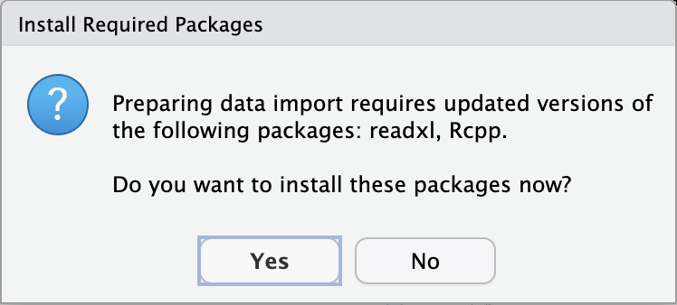
Let’s get started!
Second: Loading our first data set!
Maybe ask: “How do I load an Excel file into RStudio?”
Notes:
Loading an Excel file into RStudio is quite straightforward. Here are the steps you can follow:
Using the RStudio Interface
Open RStudio.
Go to File > Import Dataset > From Excel....
Browse and select your Excel file.
Customize the import options (e.g., sheet, range, etc.).
Click Import.
Using R Code
You can also use R code to load an Excel file. Here are two popular packages for this purpose:
Using the readxl Package
Install and load the package: install.packages("readxl")
library(readxl)
Read the Excel file: data <- read_excel("path/to/your/file.xlsx", sheet = "Sheet1")
Using the openxlsx Package
Install and load the package: install.packages("openxlsx")
library(openxlsx)
Read the Excel file: data <- read.xlsx("path/to/your/file.xlsx", sheet = 1)
These methods allow you to easily import Excel data into RStudio for analysis¹²³.
Would you like more details on any of these methods?

Slide 74
Let’s get started!
Second: Loading our first data set!
install.packages("readxl")
library(readxl)
data <- read_excel("path/to/your/file.xlsx")
What do we enter in the R session?

Slide 75
Let’s get started!
Third: Saving our data in R’s native format
Notes:
Explore
To save your data in R’s native format, you can use either the save() function or the saveRDS() function. Here’s how you can do it:
Using save()
The save() function allows you to save multiple R objects into a single file with the .RData extension.
# Save multiple objects
save(object1, object2, file = "data.RData")
You can later load this file using the load() function:
# Load the saved objects
load("data.RData")
Using saveRDS()
The saveRDS() function is used to save a single R object to a file with the .rds extension.
# Save a single object
saveRDS(object, file = "data.rds")
You can read this object back into R using the readRDS() function:
# Load the saved object
object <- readRDS("data.rds")
These methods are efficient and help in preserving the structure and attributes of your R objects¹²³.
Would you like to see an example with a specific type of data?

Slide 76
Let’s get started!
Third: Saving our data in R’s native format
save.image(file = "my_session.RData")
What do we enter in our R session?
Or any other suggestions?

Slide 77
Let’s explore the data!

Slide 78
Q: “First, the ‘Sold on’ variable in trainingTickets is in the format ‘2/8/2024 - 10:43. Can you help me create a new variable that is the number of hours from when the first person signed up, and add that to my data frame? Please do not overwrite ‘Sold on’.”

Slide 79
Q: “The ‘Sold on’ variable in RegistrationDatav1 is in the format ‘2/8/2024 - 10:43’. Could you help me create a new variable that is the number of hours from when the first person signed up, and add that to my data frame? Please do not overwrite ‘Sold on’.”
Load the necessary libraries:
library(dplyr)
Convert the Sold on column to a datetime format:
RegistrationDatav1$Sold_on <- as.POSIXct(RegistrationDatav1$Sold_on, format = "%m/%d/%Y - %H:%M”)
Calculate the number of hours from the first sign-up:
# Find the earliest sign-up time first_signup <- min(RegistrationDatav1$Sold_on, na.rm = TRUE)
# Calculate the difference in hours RegistrationDatav1 <- RegistrationDatav1 %>% mutate(Hours_from_first_signup = as.numeric(difftime(Sold_on, first_signup, units = "hours")))
RegistrationDatav1$Sold_on <- as.POSIXct(RegistrationDatav1$Sold_on, format='%m/%d/%Y - %H:%M')
Notes:
# Load necessary libraries
library(dplyr)
library(lubridate)
# Assuming your data frame is named `trainingTickets` and the column is `Sold on`
trainingTickets <- trainingTickets %>%
mutate(
# Convert 'Sold on' to datetime format
Sold_on_datetime = mdy_hm(`Sold on`),
# Find the first ticket sold time
first_sold_time = min(Sold_on_datetime),
# Calculate hours from the first sale
hours_from_first_sale = as.numeric(difftime(Sold_on_datetime, first_sold_time, units = "hours"))
)
# View the updated data frame
head(trainingTickets)

Slide 80
Q: “The ‘Sold on’ variable in RegistrationDatav1 is in the format ‘2/8/2024 - 10:43’. Could you help me create a new variable that is the number of hours from when the first person signed up, and add that to my data frame? Please do not overwrite ‘Sold on’.”
Load the necessary libraries:
library(dplyr)
Convert the Sold on column to a datetime format:
RegistrationDatav1$Sold_on <- as.POSIXct(RegistrationDatav1$Sold_on, format = "%m/%d/%Y %I:%M:%S %p") Two hours later I get: RegistrationDatav1$Sold_on_datetime <- as.POSIXct(RegistrationDatav1$`Sold on`, format = "%m/%d/%Y - %H:%M")
Calculate the number of hours from the first sign-up:
# Find the earliest sign-up time first_signup <- min(RegistrationDatav1$Sold_on, na.rm = TRUE)
# Calculate the difference in hours RegistrationDatav1 <- RegistrationDatav1 %>% mutate(Hours_from_first_signup = as.numeric(difftime(Sold_on, first_signup, units = "hours")))
RegistrationDatav1$Sold_on <- as.POSIXct(RegistrationDatav1$Sold_on, format='%m/%d/%Y - %H:%M')

Slide 81
Q: “The ‘Sold on’ variable in RegistrationDatav1 is in the format ‘2/8/2024 - 10:43’. Could you help me create a new variable that is the number of hours from when the first person signed up, and add that to my data frame? Please do not overwrite ‘Sold on’.”
Load the necessary libraries:
library(dplyr)
What happens?
Calculate the number of hours from the first sign-up:
# Find the earliest sign-up time first_signup <- min(RegistrationDatav1$Sold_on, na.rm = TRUE)

Slide 82
Q: “The ‘Sold on’ variable in RegistrationDatav1 is in the format ‘2/8/2024 - 10:43’. Could you help me create a new variable that is the number of hours from when the first person signed up, and add that to my data frame? Please do not overwrite ‘Sold on’.”
Load the necessary libraries:
library(dplyr)
What happens? OK - solved!
Calculate the number of hours from the first sign-up:
# Find the earliest sign-up time first_signup <- min(RegistrationDatav1$Sold_on, na.rm = TRUE)
What happens? OK - we need to rename the column or even better inspect the Excel file in the beginning and address the issue earlier.

Slide 83
Q: “First, the ‘Sold on’ variable in RegistrationDatav1 is in the format ‘2/8/2024 - 10:43’. Can you help me create a new variable that is the number of hours from when the first person signed up, and add that to my data frame? Please do not overwrite ‘Sold on’.”

Slide 84
Q: “Using R after having loaded an Excel file and trying to transform the column 'Sold on', I get this error: Unknown or uninitialised column: `Sold_on`. What can I do?”
It sounds like there might be a mismatch between the column name you’re trying to reference and the actual column name in your Excel file. Here are a few steps you can take to troubleshoot and resolve this issue:
Check Column Names: Ensure that the column name in your Excel file is exactly Sold on and not Sold_on. Excel column names are case-sensitive and must match exactly.
# Rename the column
colnames(data)[colnames(data) == "Sold on"] <- "Sold_on"

Slide 85
Let’s go back to our original answer.

Slide 86
Q: “I’m attaching my original data frame again for you. Can you generate code for me to get a histogram of the new variable, HoursSinceFirst?”
Notes:
A great way to capture the underlying density of the histogram is to use a density plot. This plot will give you a smooth estimate of the distribution of your data. In R, you can use the density() function to create a density plot.

Slide 87
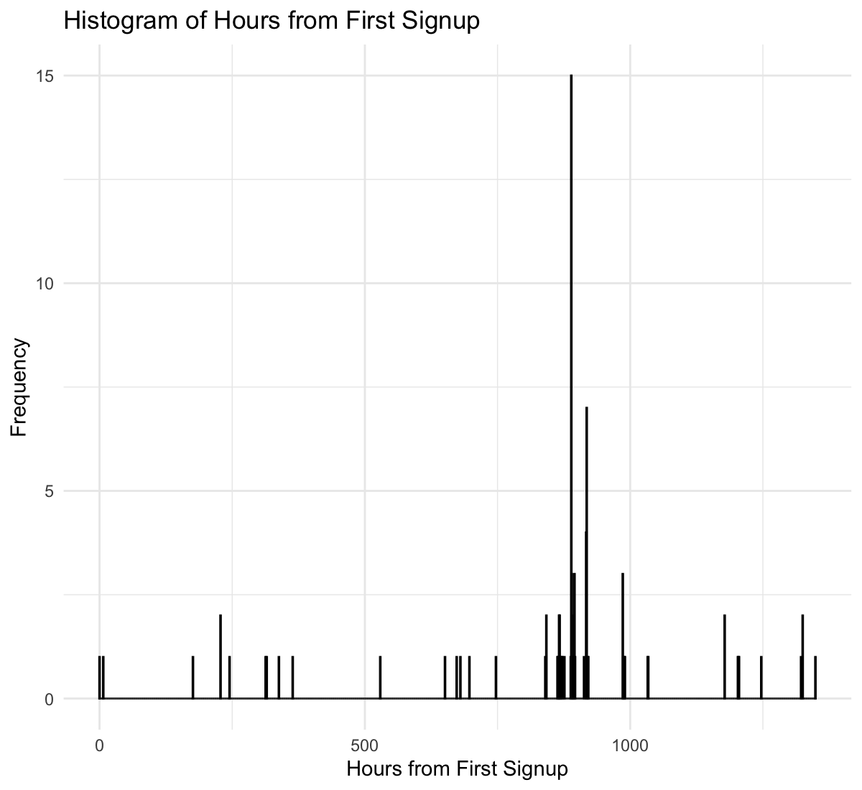
Q: “I’m attaching my original data frame again for you. Can you generate code for me to get a histogram of the new variable, HoursSinceFirst?”
Notes:
ggplot(RegistrationDatav1, aes(x = Hours_from_first_signup)) +
geom_histogram(binwidth = 1, fill = "blue", color = "black") +
labs(title = "Histogram of Hours from First Signup",
x = "Hours from First Signup",
y = "Frequency") +
theme_minimal()

Slide 88
Q: “I’m attaching my original data frame again for you. Can you generate code for me to get a histogram of the new variable, HoursSinceFirst?”

Slide 89
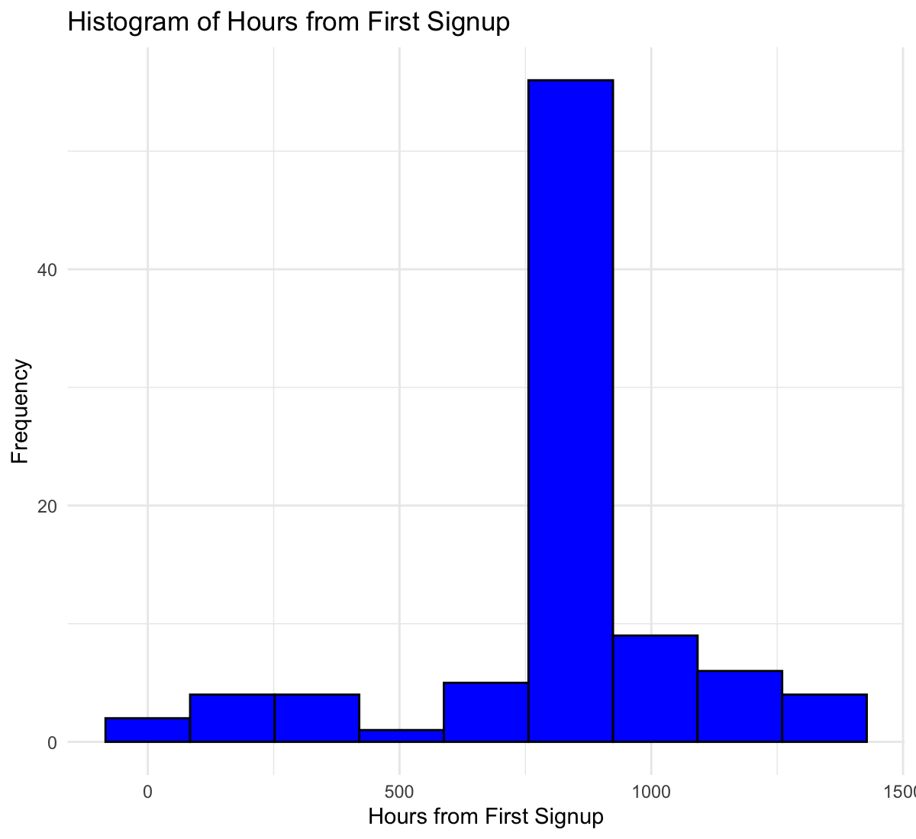
Q: “Oh, I see that there are way too many bins. Can you do it again, but grouping by week?”

Slide 90
Q: “What's a good way to capture the underlying the density of this histogram?”

Slide 91
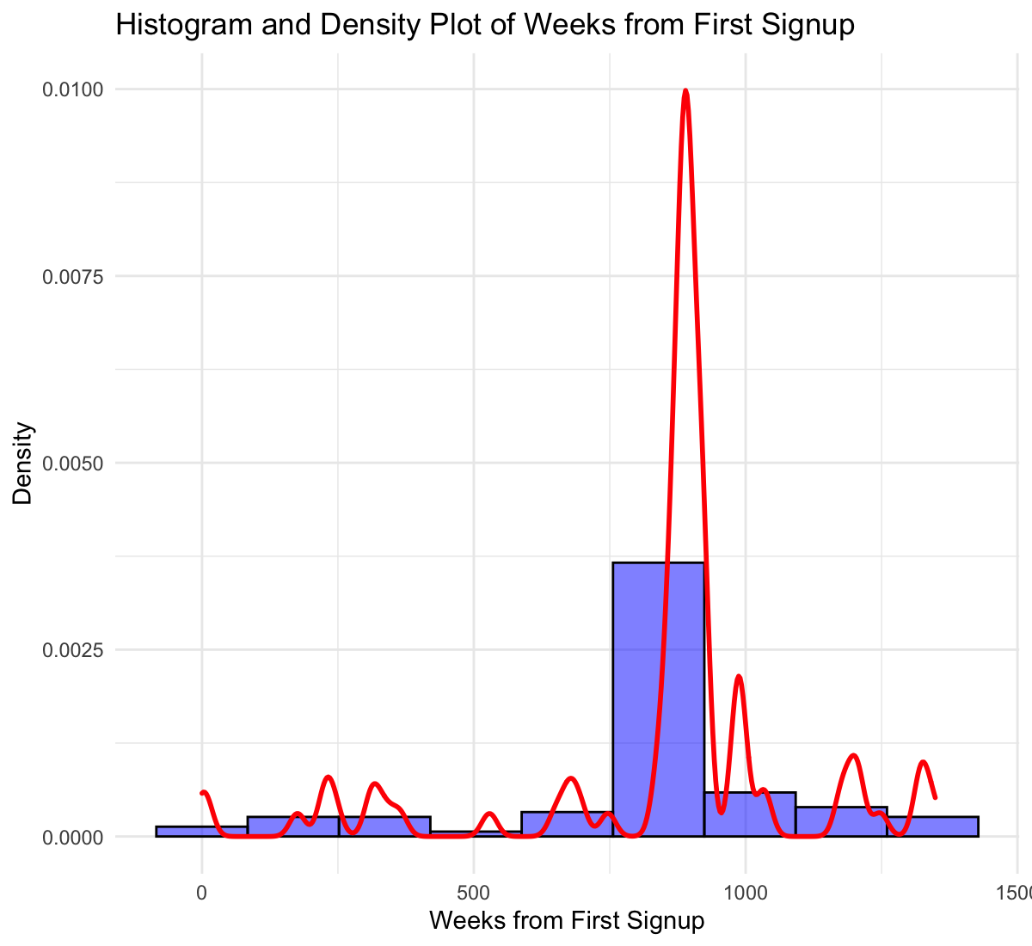
Q: “What's a good way to capture the underlying the density of this histogram?”
A great way to capture the underlying density of the histogram is to use a density plot. This will give you a smooth curve that represents the distribution of your data. You can overlay this density plot on your histogram for better visualization

Slide 92
Q: “I need it to be “wigglier”, so that it captures the ups and downs of the data better.”

Slide 93
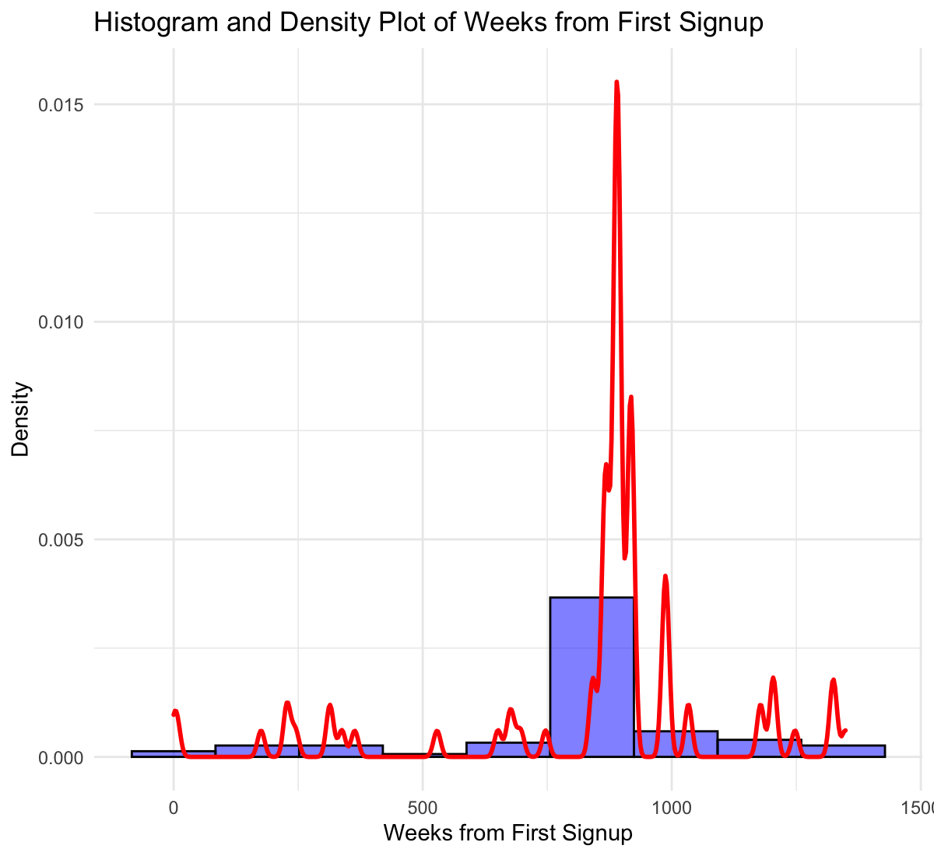
Q: “I need it to be “wigglier”, so that it captures the ups and downs of the data better.”
To make the density plot “wigglier” and capture more of the ups and downs, you can adjust the adjust parameter in the geom_density function. This parameter controls the bandwidth of the density estimate. A smaller value will make the plot more sensitive to the data’s variations.

Slide 94
Elements to document your AI use
Tool name and version (e.g., ChatGPT 4 Turbo)
Time and date of usage
Text or screenshots of prompt or query
Generated text responses
Follow-up queries and responses
Name of person who queried
Links to original chats can fail, so consider archiving them elsewhere
Notes:
So beyond the question of AI and authorship, let's talk through some of the other scenarios researchers may use AI in the writing process. First of, we'll look at using GenAI to shape the style, tone, or formatting of your drafts.
Compared to the question of authorship, when it comes to using AI as a research or writing assistant, guidelines tend to vary a little in how this kind of use should be acknowledged and described.
For example, most publisher and journal policies allow for AI tools to be used for research and writing assistants, as long as you are transparent about your use. But "transparent" can vary, from describing your use of AI tools in your submission cover letter, your Methods or Acknowledgements sections, or sharing more extensive details as an Appendix to your paper.
On the other end of the spectrum, the STM Association only requires disclosing AI use if it goes beyond "basic author support," which they define as functions like refining, correcting, and editing drafts.
So, the more you plan for transparency from the outset of your project, the better positioned you will be to be able to meet specific journal, publisher, or funder policies.

Slide 95
CANGARU Project ─ Standardizing Author Guidelines
Partnership between researchers and publishers including Elsevier, Springer Nature, Wiley; representatives from journals eLife, Cell, and The BMJ; as well as industry body the Committee on Publication Ethics. The group hopes to release guidelines soon (before end of 2024), which will be updated annually.
Project overview: https://arxiv.org/pdf/2307.08974
Notes:
Finally, while publisher policies are currently somewhat varied, there is a new group called CANGARU ("ChatGPT, Generative Artificial Intelligence and Natural Large Language Models for Accountable Reporting and Use Guidelines") made up of a coalition of researchers, publishers, and representatives from journals and COPE, that is aiming to release a more standardized set of researcher AI guidelines this summer, which will be updated annually. So, keep an eye on this group.
—-CITATIONS
Else, Holly. Science. "Should researchers use AI to write papers? Group aims for community-driven standards" 16 Apr. 2024. https://www.science.org/content/article/should-researchers-use-ai-write-papers-group-aims-community-driven-standards
Accessed 18 Apr. 2024
CANGARU Open Science Framework repository: https://osf.io/9y5nw/wiki/home/

